Slide 1
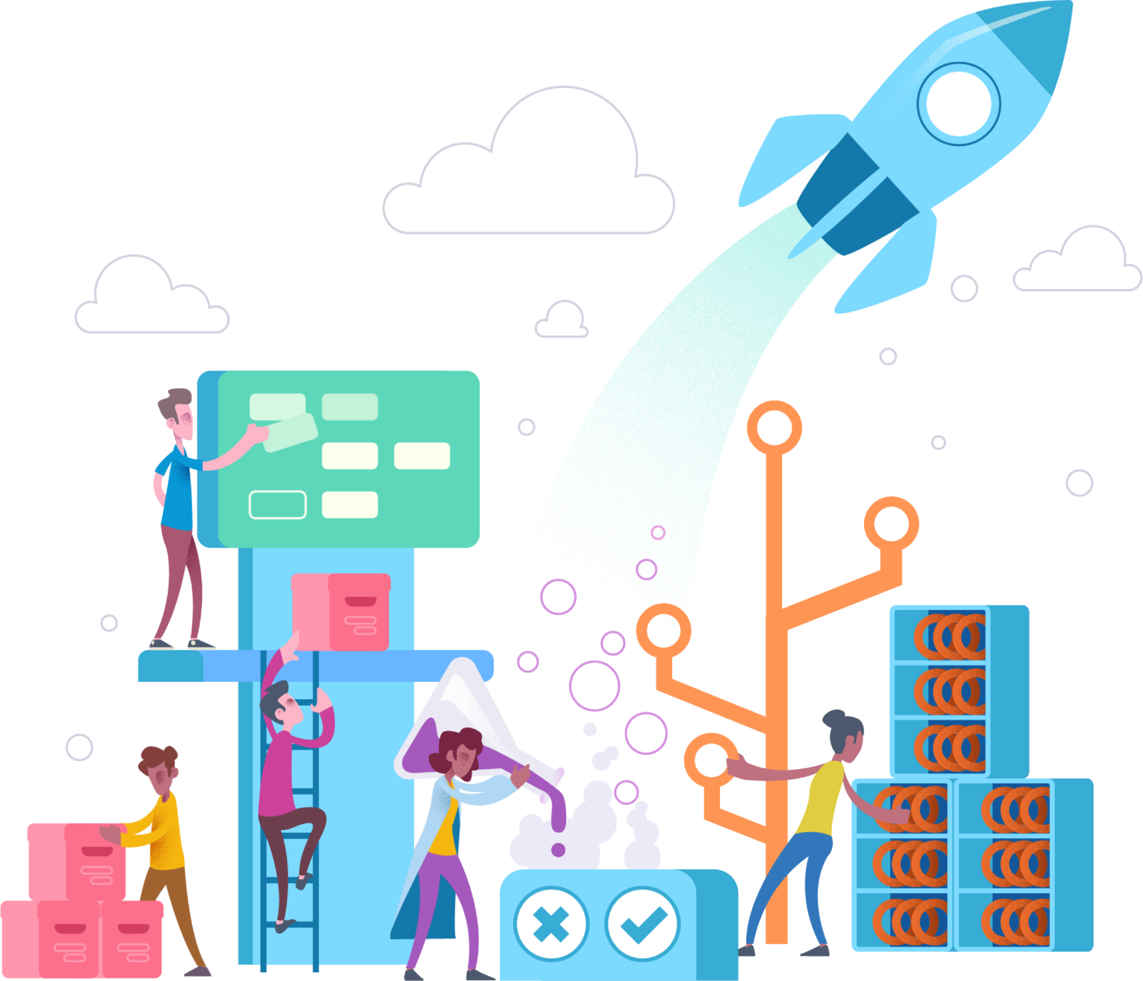
Azure DevOps
Jivane Rajabaly - PreSales Engineer
Francois-Xavier - Kim PreSales Engineer
2019

Slide 2
Agenda
09h00 - 09h30 : Accueil et introduction
09h30 - 10h30 : Presentation
10h45 - 11h30 : WhiteBoard Design Session
11h30 - 12h30 : Hands On Lab – Setup
12h30 - 13h30 : Déjeuner
13h30 - 15h30 : Hands On Lab – Part#1
15h45 - 16h45 : Hands On Lab – Part #2
16h45 - 17h00 : Conclusion
FX

Slide 3


Why DevOps?
Business benefits
A faster, more agile, and more flexible business capable of adapting quickly and rolling out new apps and services to meet new demands and business opportunities at speed.
A platform for operational improvement and continuous innovation that enables organizations to rapidly innovate and scale new products.
The ability to replace elements in the value creation chain when something better comes along, rather than being locked into past technology choices.
Technology benefits
A software delivery pipeline that enables more frequent and more stable releases.
Through automation of software testing and deployment, lower change failure rates and in the case of a failure, faster mean time to recovery.
A faster, more collaborative, and more empowered development team that is able to innovate with ease.
Notes:
The ability to continually deploy and update applications without disrupting the user experience is at the core of a digitally transformed company.
In fact, companies that can’t do this fast enough will be left behind.
Those that stick to legacy development models will find that the market, and their customers’ expectations, have changed by the time they deploy their application, moving them and their product further behind the competition.
DevOps solves this by keeping pace with customer demand and the speed of technology.

Slide 4
Common software delivery challenges
Low deployment frequency
High lead time for changes
!
High change failure rate
Long mean time to recover

Slide 5
What is DevOps?
People. Process. Products.
Build& Test
Deploy
DevOps is the union of people, process, and products to enable continuous delivery of value to your end users.
“
Continuous Delivery
Develop
Operate
”
Plan & Track
Monitor & Learn
Notes:
DevOps is the union of people, process and products to enable the continuous delivery of value to your end customers

Slide 6
What technologies do I need to support DevOps?
DevOps brings together people, processes, and technology, automating software delivery to provide continuous value to your users. Using Azure DevOps, you can deliver software faster and more reliably - no matter how big your IT department or what tools you’re using.
Continuous Integration (CI)
Improve software development quality and speed.
When you use Azure Pipelines or Jenkins to build apps in the cloud and deploy to Azure, each time you commit code, it’s automatically built and tested and bugs are detected faster.
Continuous Deployment (CD)
By combining continuous integration and infrastructure as code (IaC), you’ll achieve identical deployments and the confidence to deploy to production at any time.
With continuous deployment, you can automate the entire process from code commit to production if your CI/CD tests are successful.
Continuous Learning & Monitoring
With Azure Application Insights you can identify how your applications are performing and test if the recent deployment made things better or worse.
Using CI/CD practices, paired with monitoring tools, you’ll be able to safely deliver features to your customers as soon as they’re ready.

Slide 7





Introducing Azure DevOps
Azure Boards
Azure Pipelines
Azure Repos
Deliver value to your users faster using proven agile tools to plan, track, and discuss work across your teams.
Build, test, and deploy with CI/CD that works with any language, platform, and cloud. Connect to GitHub or any other Git provider and deploy continuously.
Get unlimited, cloud-hosted private Git repos and collaborate to build better code with pull requests and advanced file management.
Azure Test Plans
Azure Artifacts
➔
Test and ship with confidence using manual and exploratory testing tools.
Create, host, and share packages with your team, and add artifacts to your CI/CD pipelines with a single click.
https://azure.com/devops
Notes:
So does TFS

Slide 8


DevOps with Azure
Azure Test Plans
Azure Pipelines
Build& Test
Deploy
Azure Artifacts
Continuous Delivery
Develop
Operate
Azure Repos
Plan & Track
Monitor & Learn
Application Insights
Azure Boards
Log Monitor

Slide 9
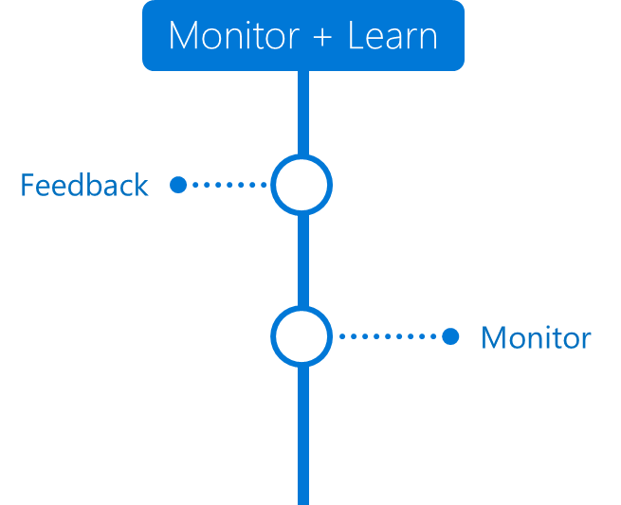
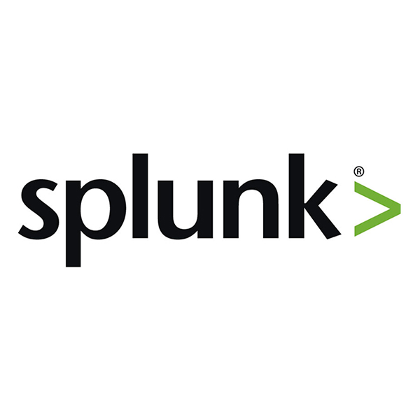
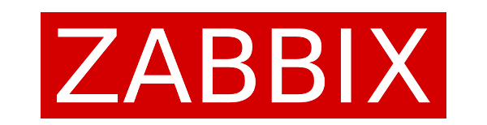
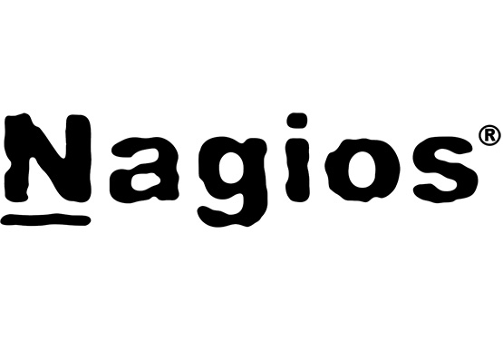
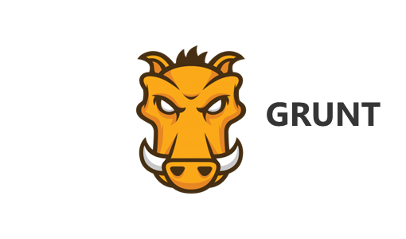
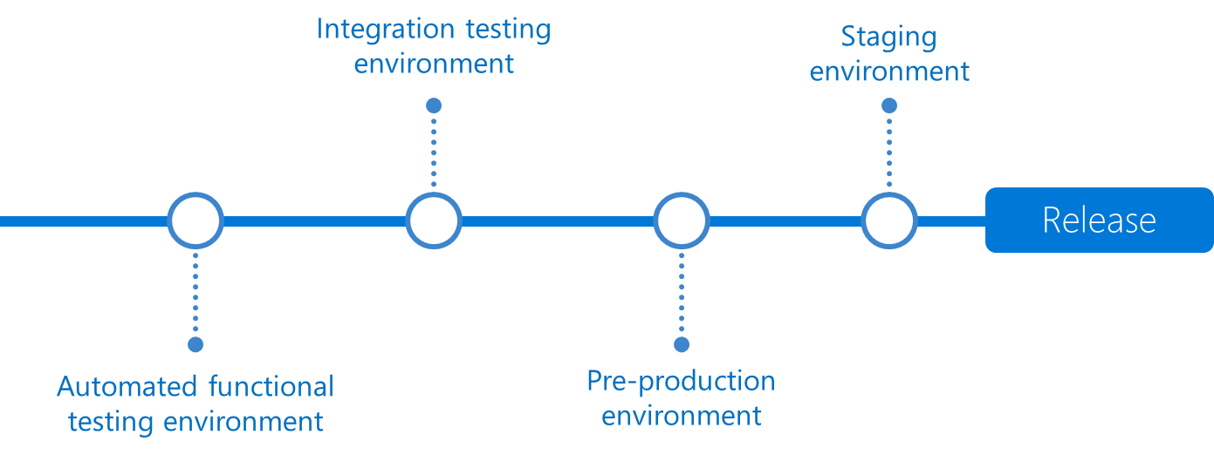
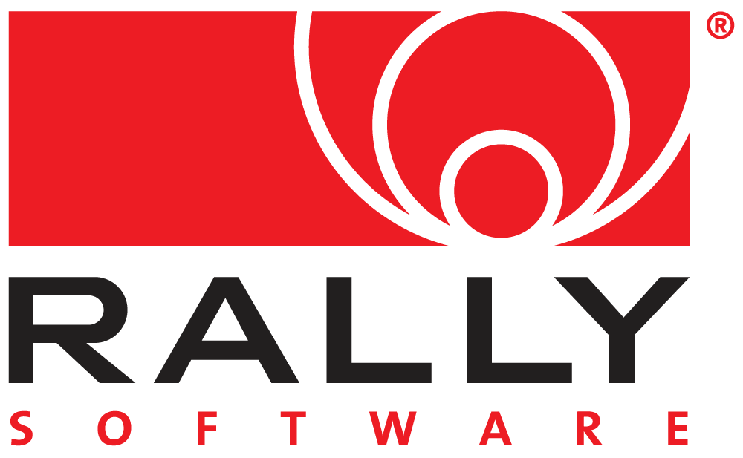

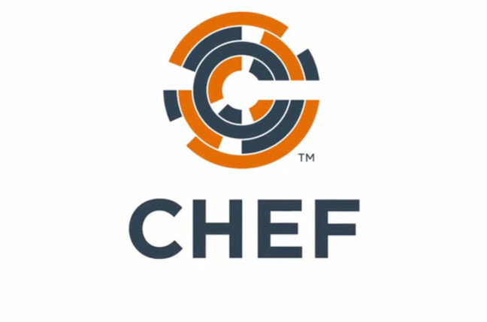
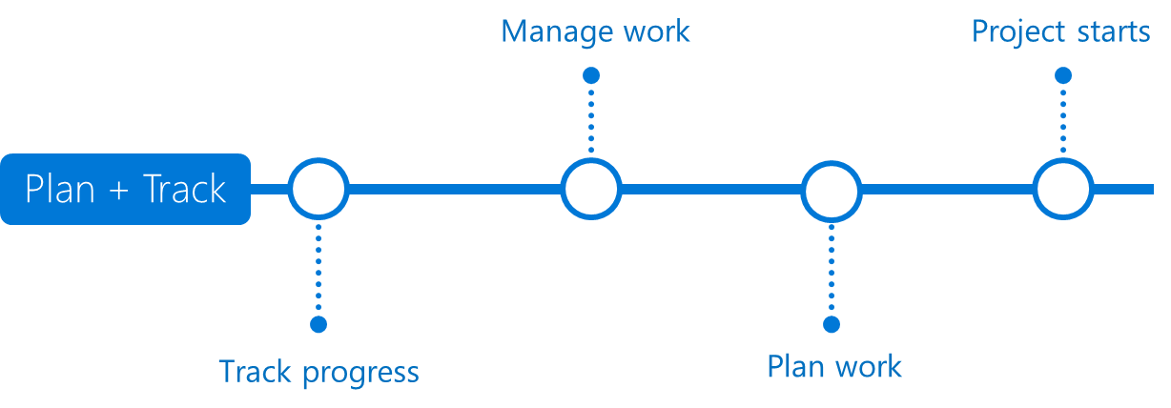

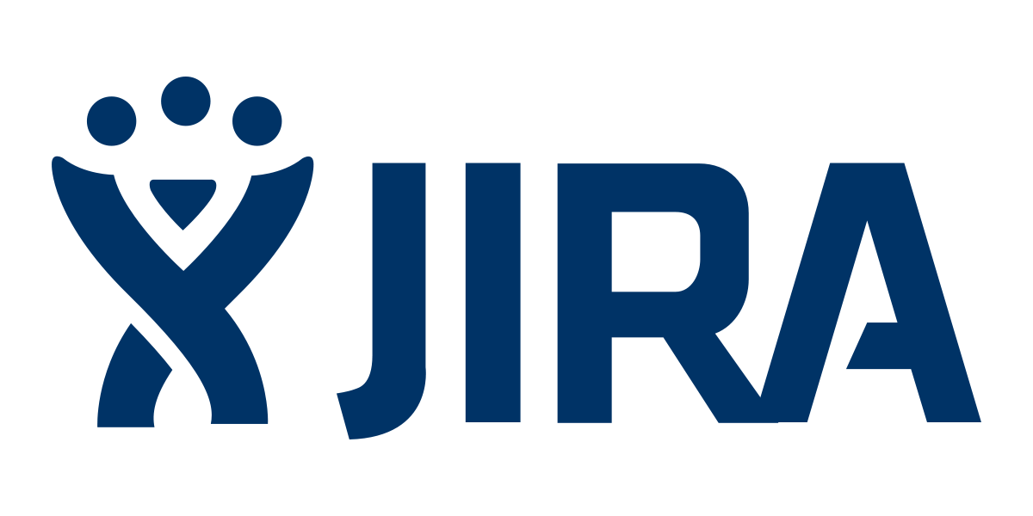
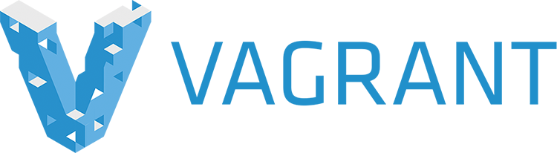




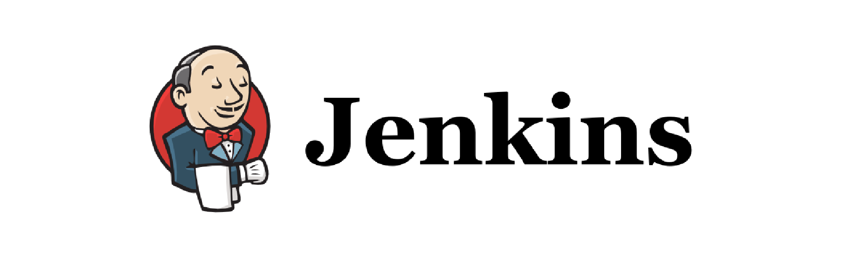
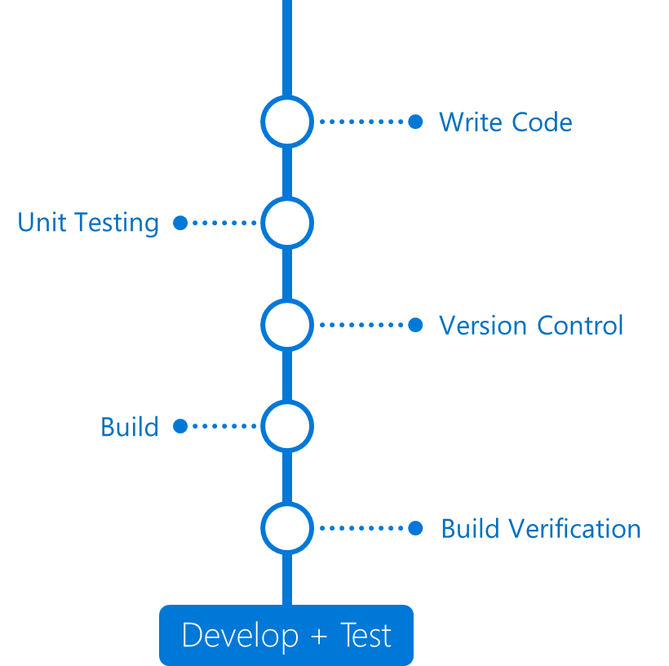
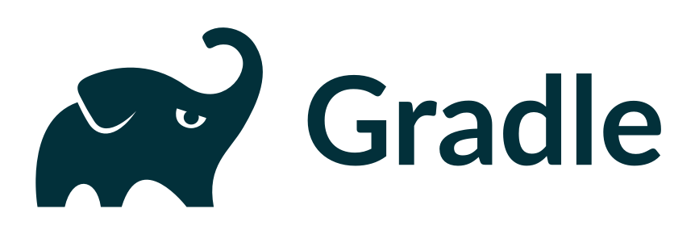
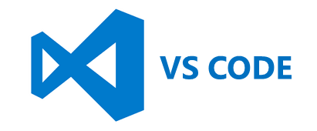
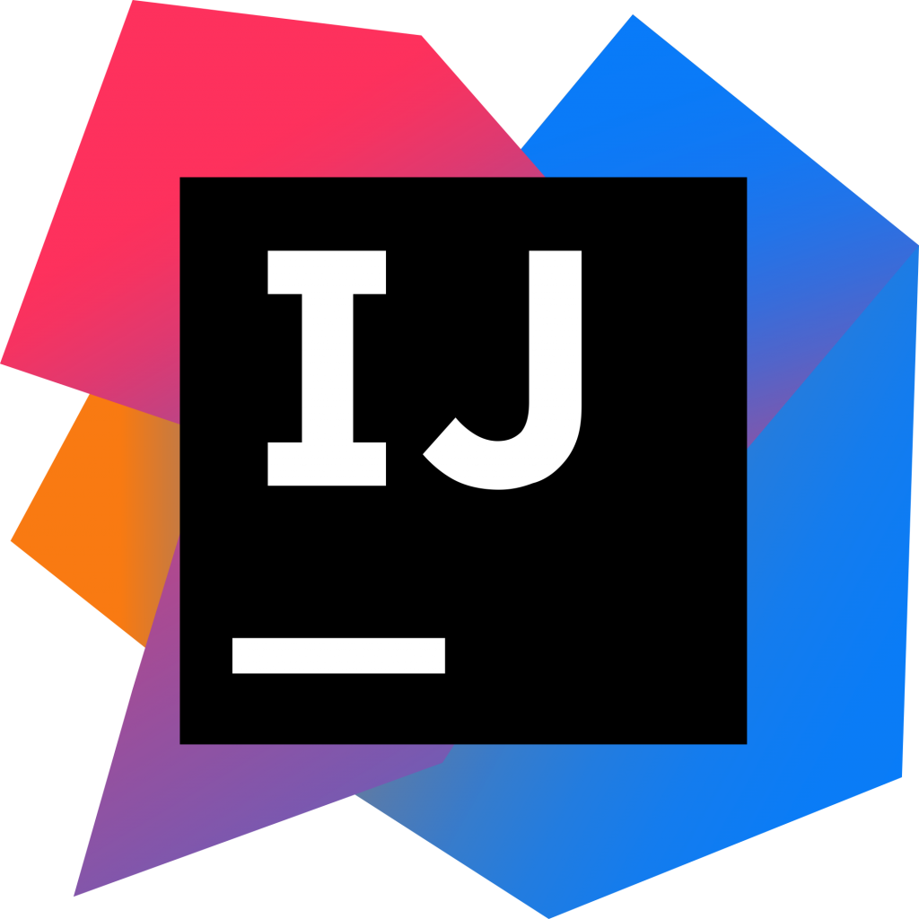
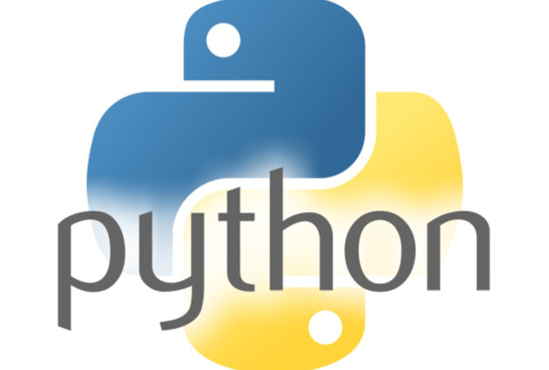
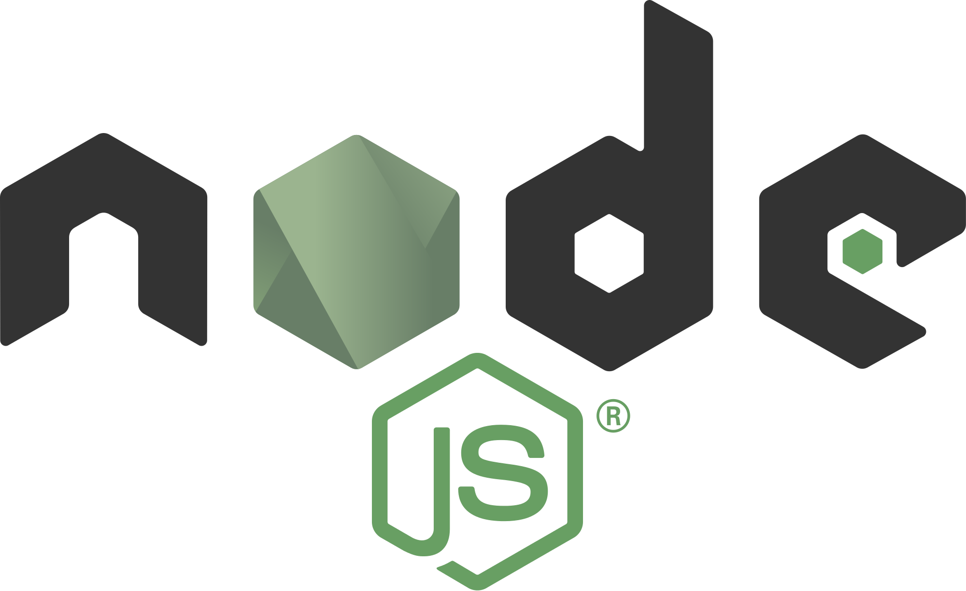
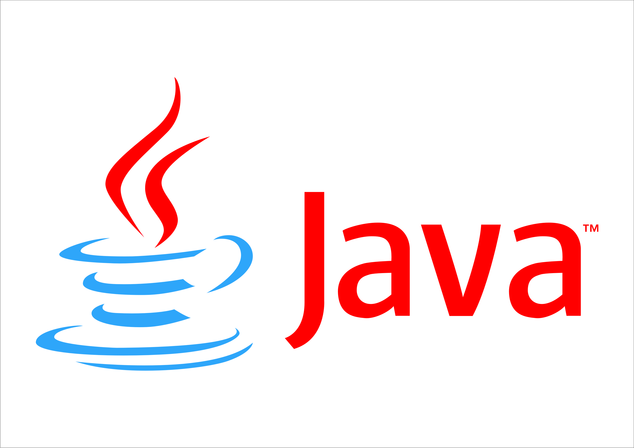

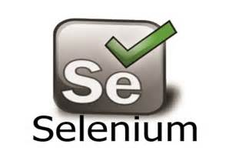
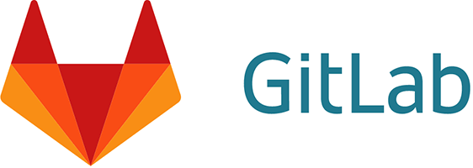
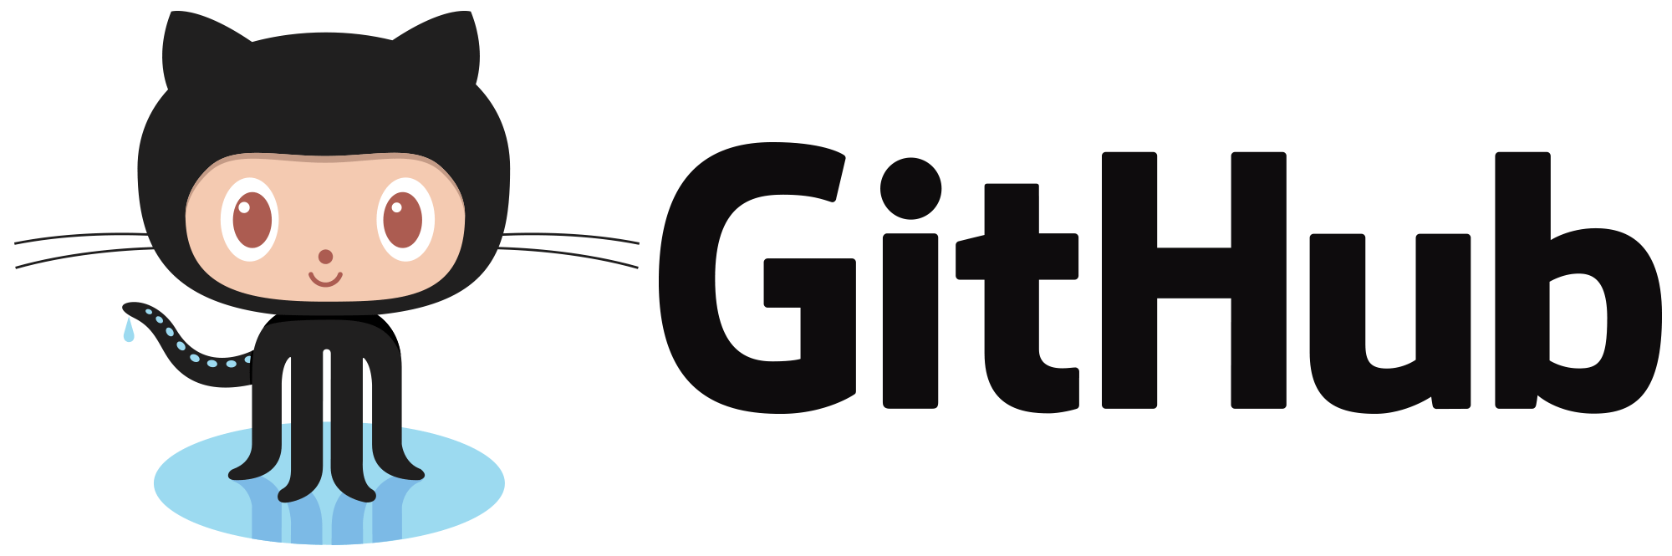
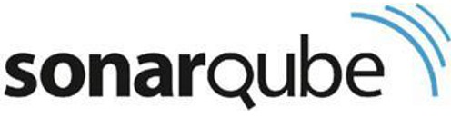
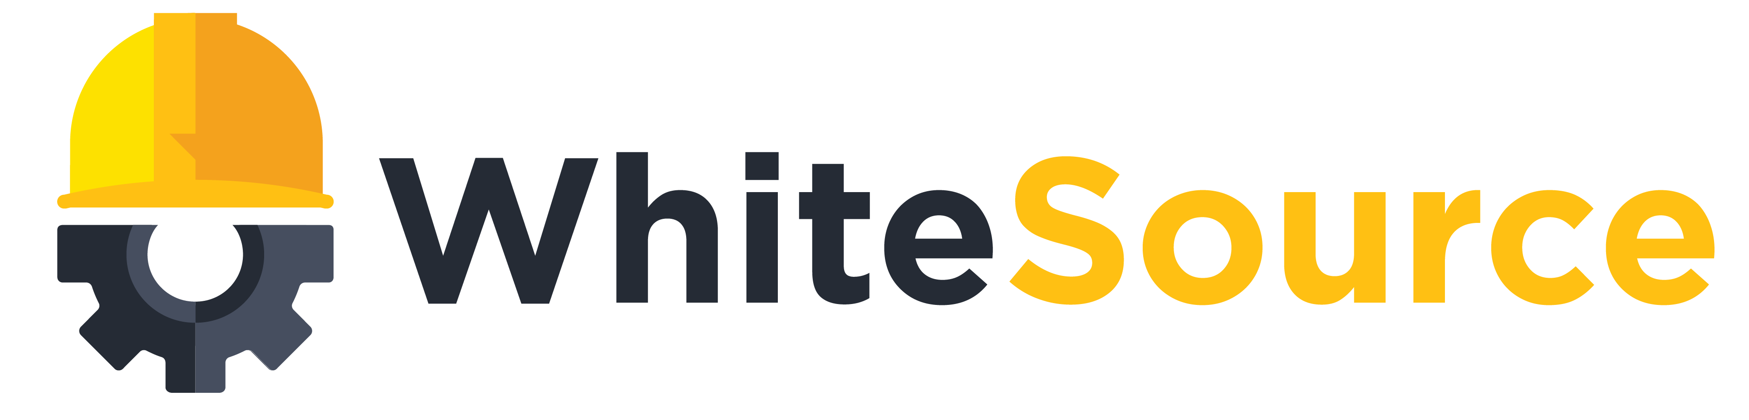
DevOps & OSS
DevOps
DevOps
Notes:
DevOps is the union of people, process, and products to enable continuous delivery of value to end users.
The contraction of Dev and Ops refers to replacing silo’ed Development and Operations to create multidisciplinary teams that now work together with shared and efficient practices and tools.
Essential DevOps practices include CLICK
agile planning, CLICK
continuous integration, CLICK
continuous delivery, CLICK
and monitoring of applications.
CLICK DevOps becomes reality with powerful tools that help development teams move through the different phases of the DevOps lifecycle quickly and efficiently.
There are many powerful best-of-breed point solutions – both OSS and commercial – available today.
These tools cover individual DevOps tasks or entire phases, and teams choose and integrate their preferred tools in order to get an end-to-end toolchain that works for them.
CLICK Visual Studio Team Services (VSTS) is our Azure OSS DevOps solution and it is an easy and flexible offering.
It’s enterprise class, integrated from end to end, extensible, and works with other tools.
It ties everything together – program in any language, develop on any operating system, and deploy to any platform.
It’s best with Azure, but it integrates with other cloud providers, giving users the flexibility to explore and gradually move to Azure.
We do not ask you to stop promoting your favorite OSS DevOps tools – quite the opposite, we want your customers move the tools they are using to Azure.
However, we do want you to keep in mind that VSTS is a great integration platform that can work with your OSS tool of choice and also brings additional value if you include it as part of an existing OSS DevOps setup.
How? Let’s take Jenkins as an example.
Jenkins is a great tool and best-of-breed OSS solution. Jenkins runs on Azure, in fact you can provision a fully functional Jenkins instance in just a few minutes from the Azure portal. That’s a great start and will create some consumption.
But Jenkins also has some drawbacks from past experience:
Managing Jenkins infrastructure can be cumbersome. It requires a master/slave relationship between all build nodes. As a team grows, they will require more builds which in turns requires more build nodes. From an infrastructure perspective, you need a dedicated team to manage that whole setup to ensure it runs smoothly.
Security within Jenkins is enforced via plugins and highly complex to setup (when compared to VSTS).
The plugin ecosystem is wide but there a lot of plugins that cause stability issues within Jenkins.
Upgrading Jenkins is very painful which results in more teams using outdated version of Jenkins which can cause security risks.
Integrating Jenkins with other tools like Jira or Github is cumbersome (while VSTS provides features from all tools within one product).
If a Jenkins setup is mission-critical then setting up Jenkins in HA is extremely hard considering its backend is a filesystem rather than a database. Consequently, teams will tend to scale the Jenkins master vertically instead of horizontally as the number of jobs increases. The on-premises team is responsible to provide a decent SLA to the dev/ops teams.
This is not to say that teams should stop using Jenkins – but they should be aware how VSTS can help mitigate some of the drawbacks.
This was just an example of one tool in an end-to-end DevOps toolchain.
If your customer is using multiple different tools, similar issues will crop up every time.

Slide 10
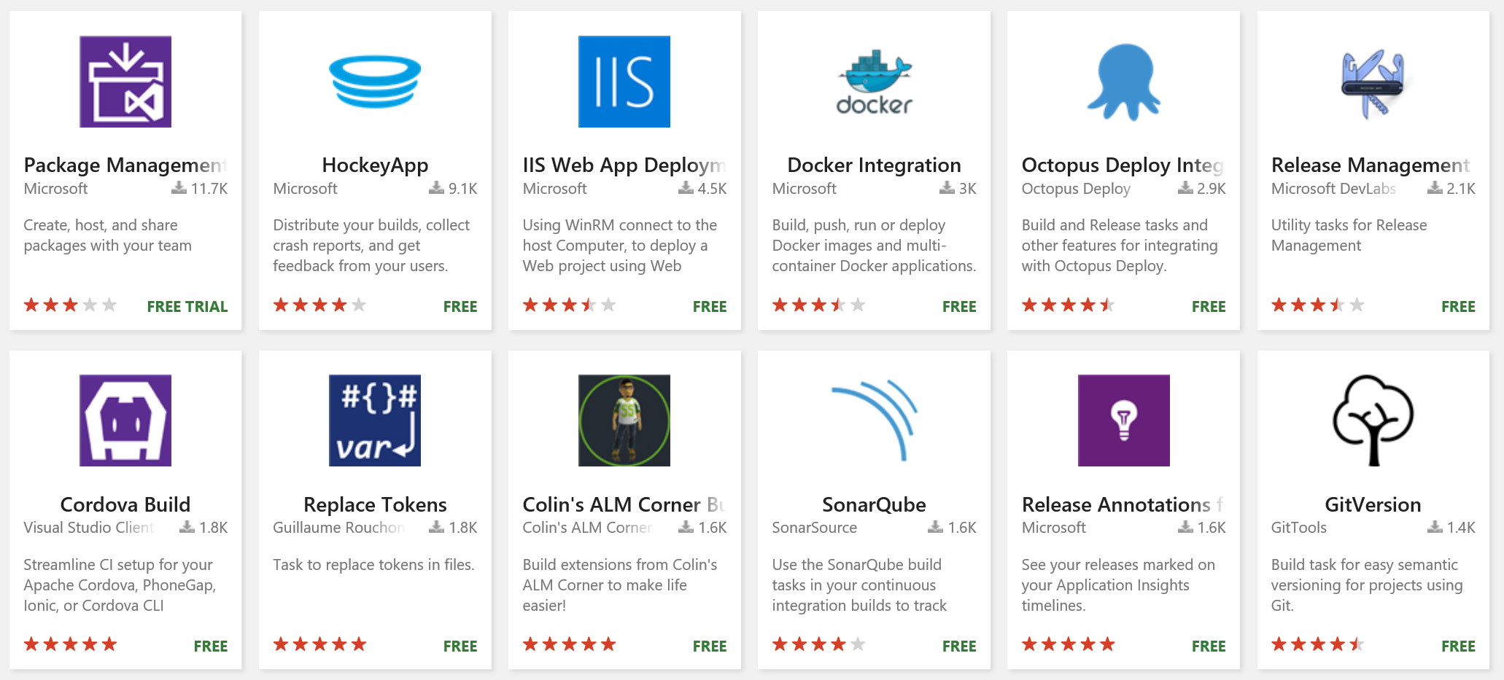
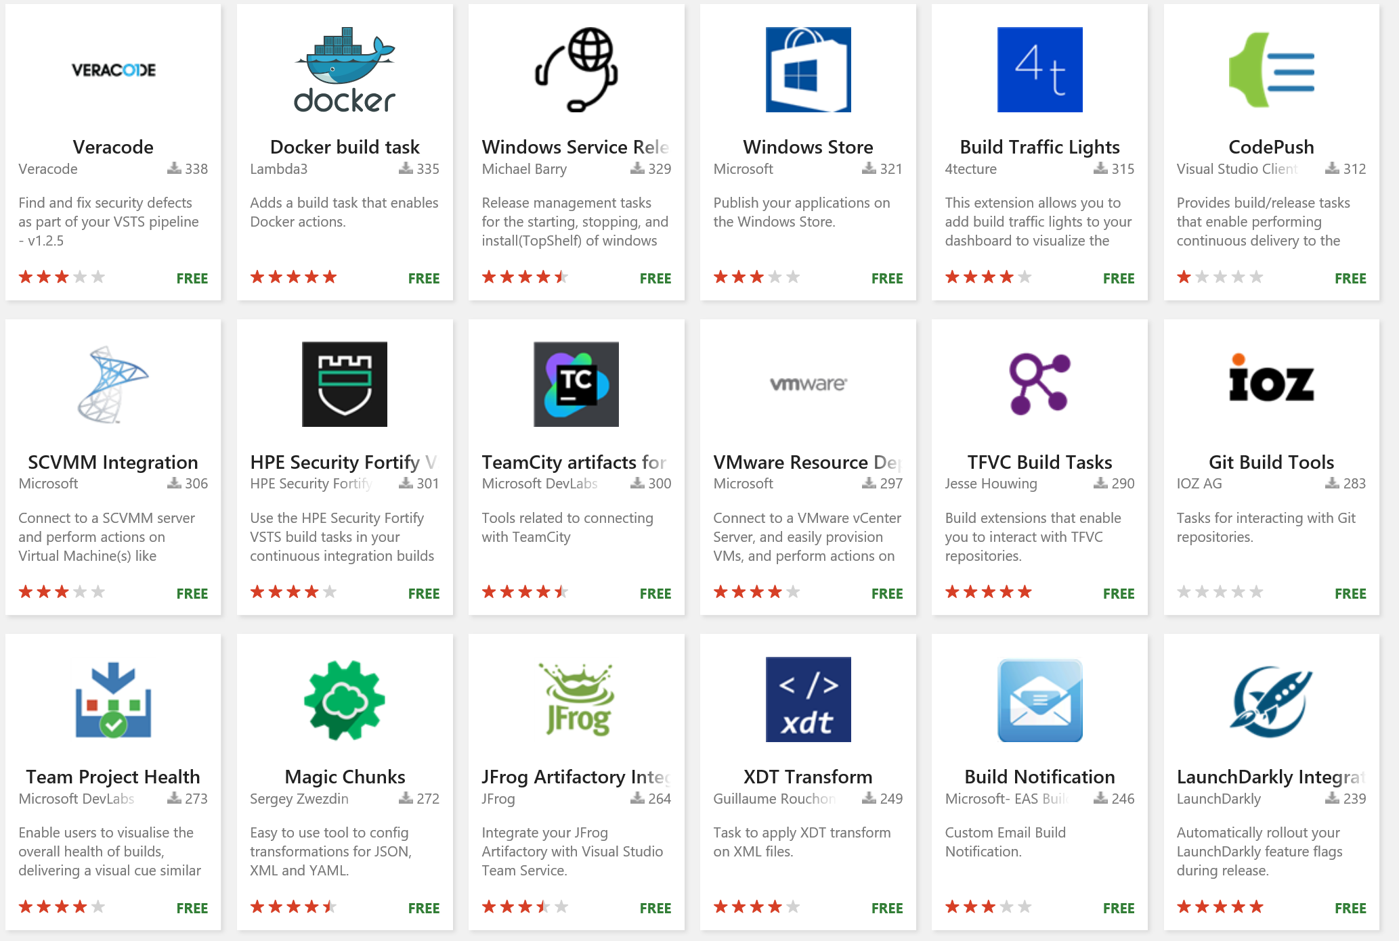
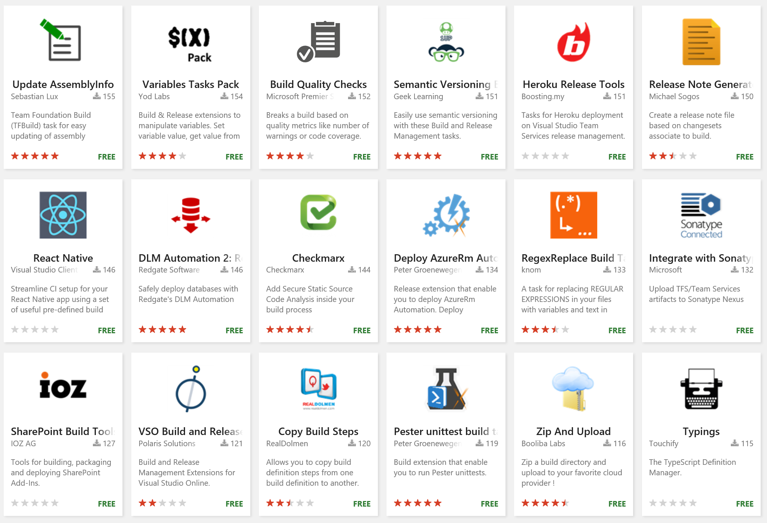
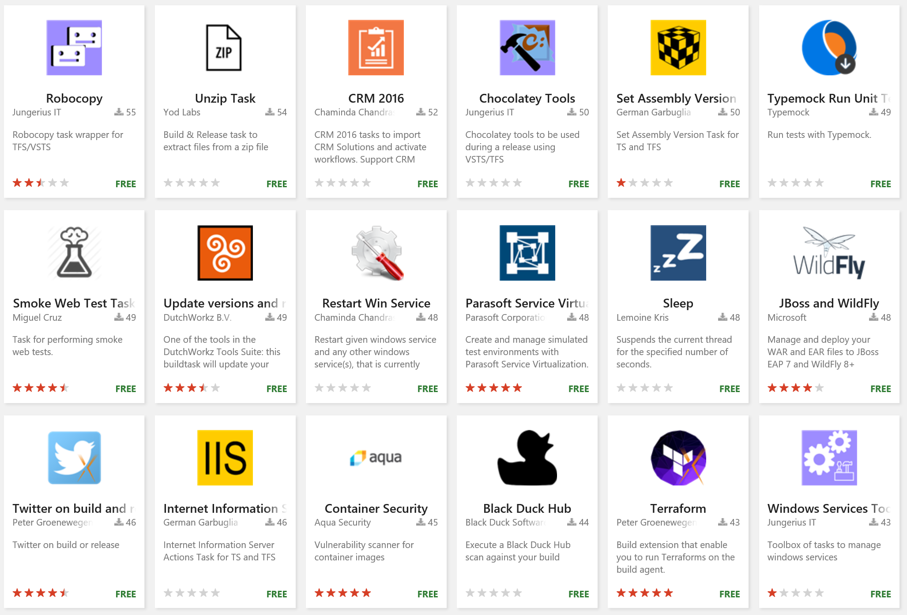
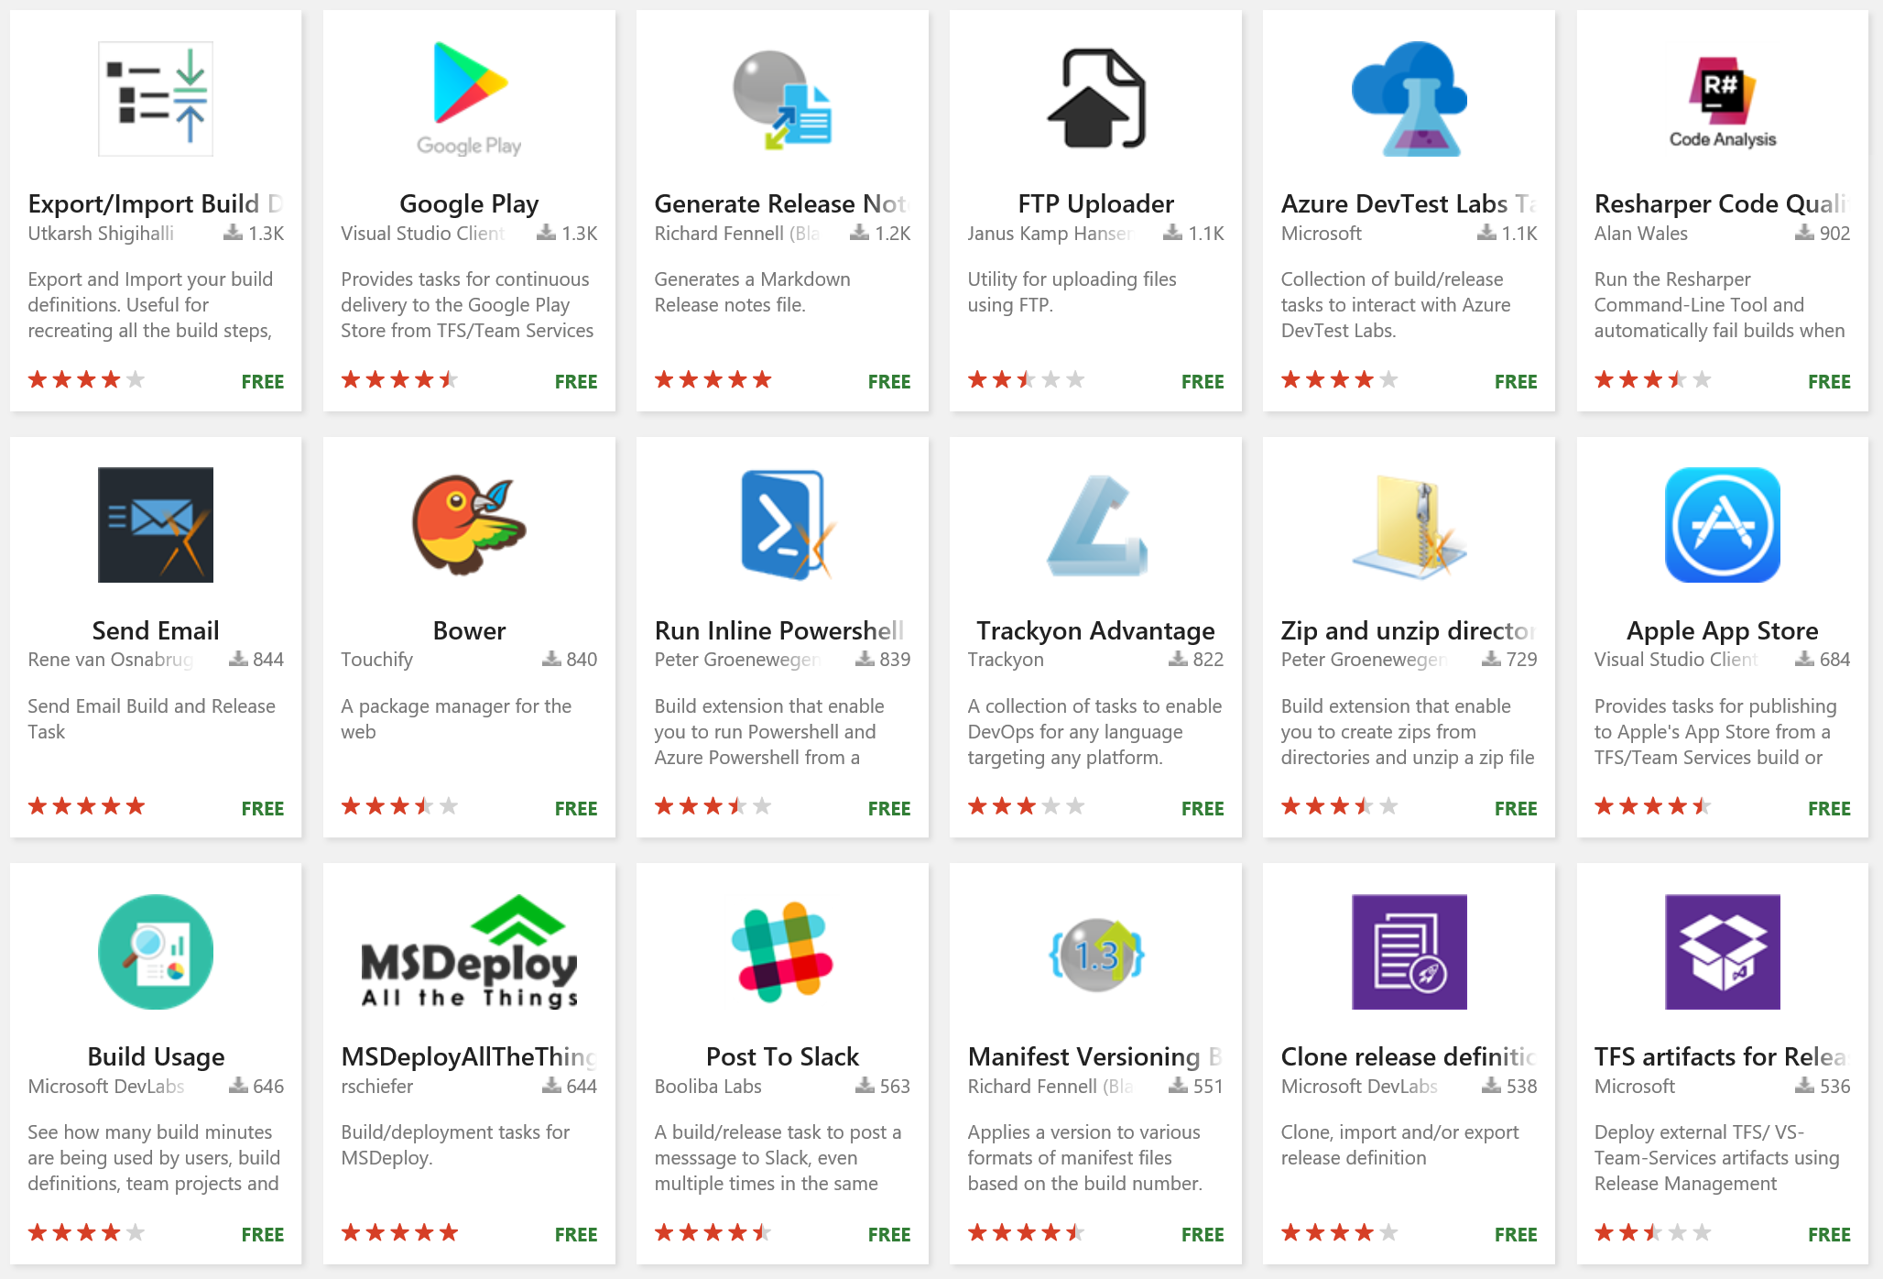
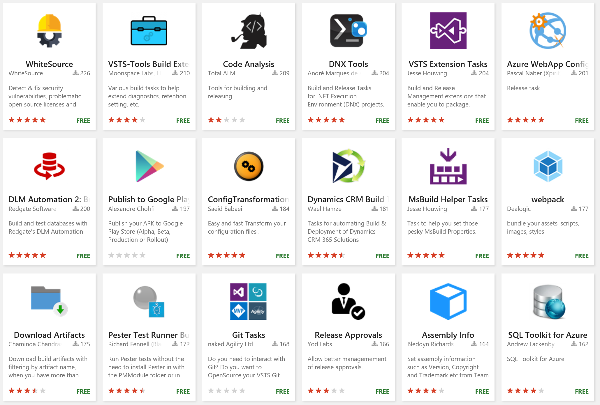
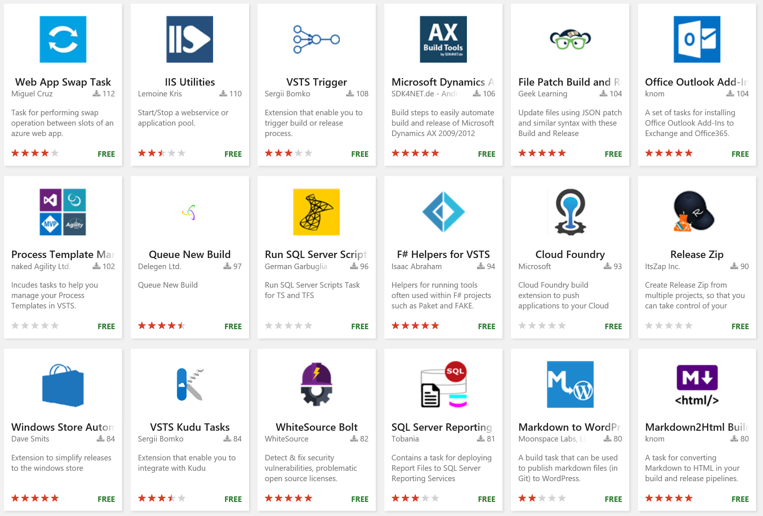
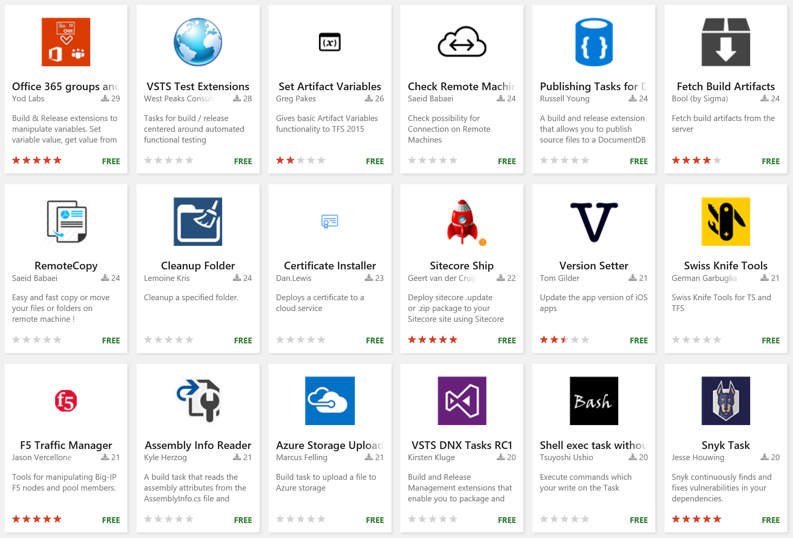
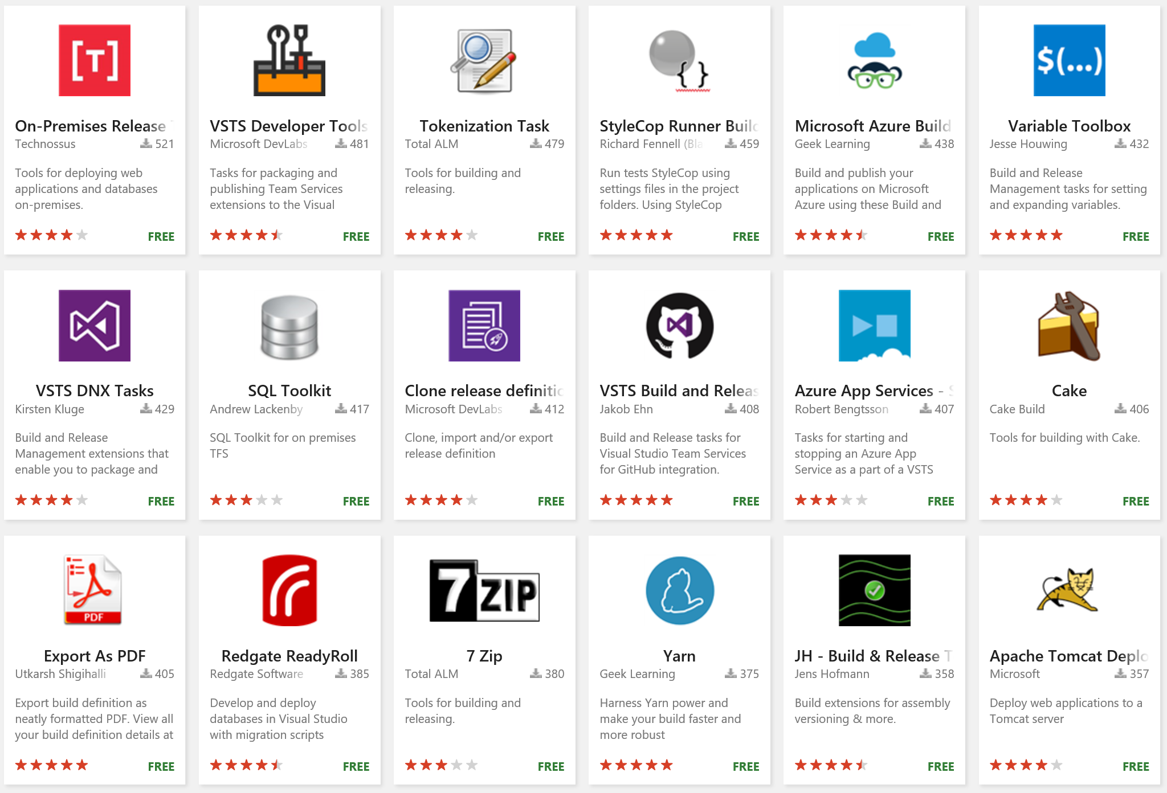
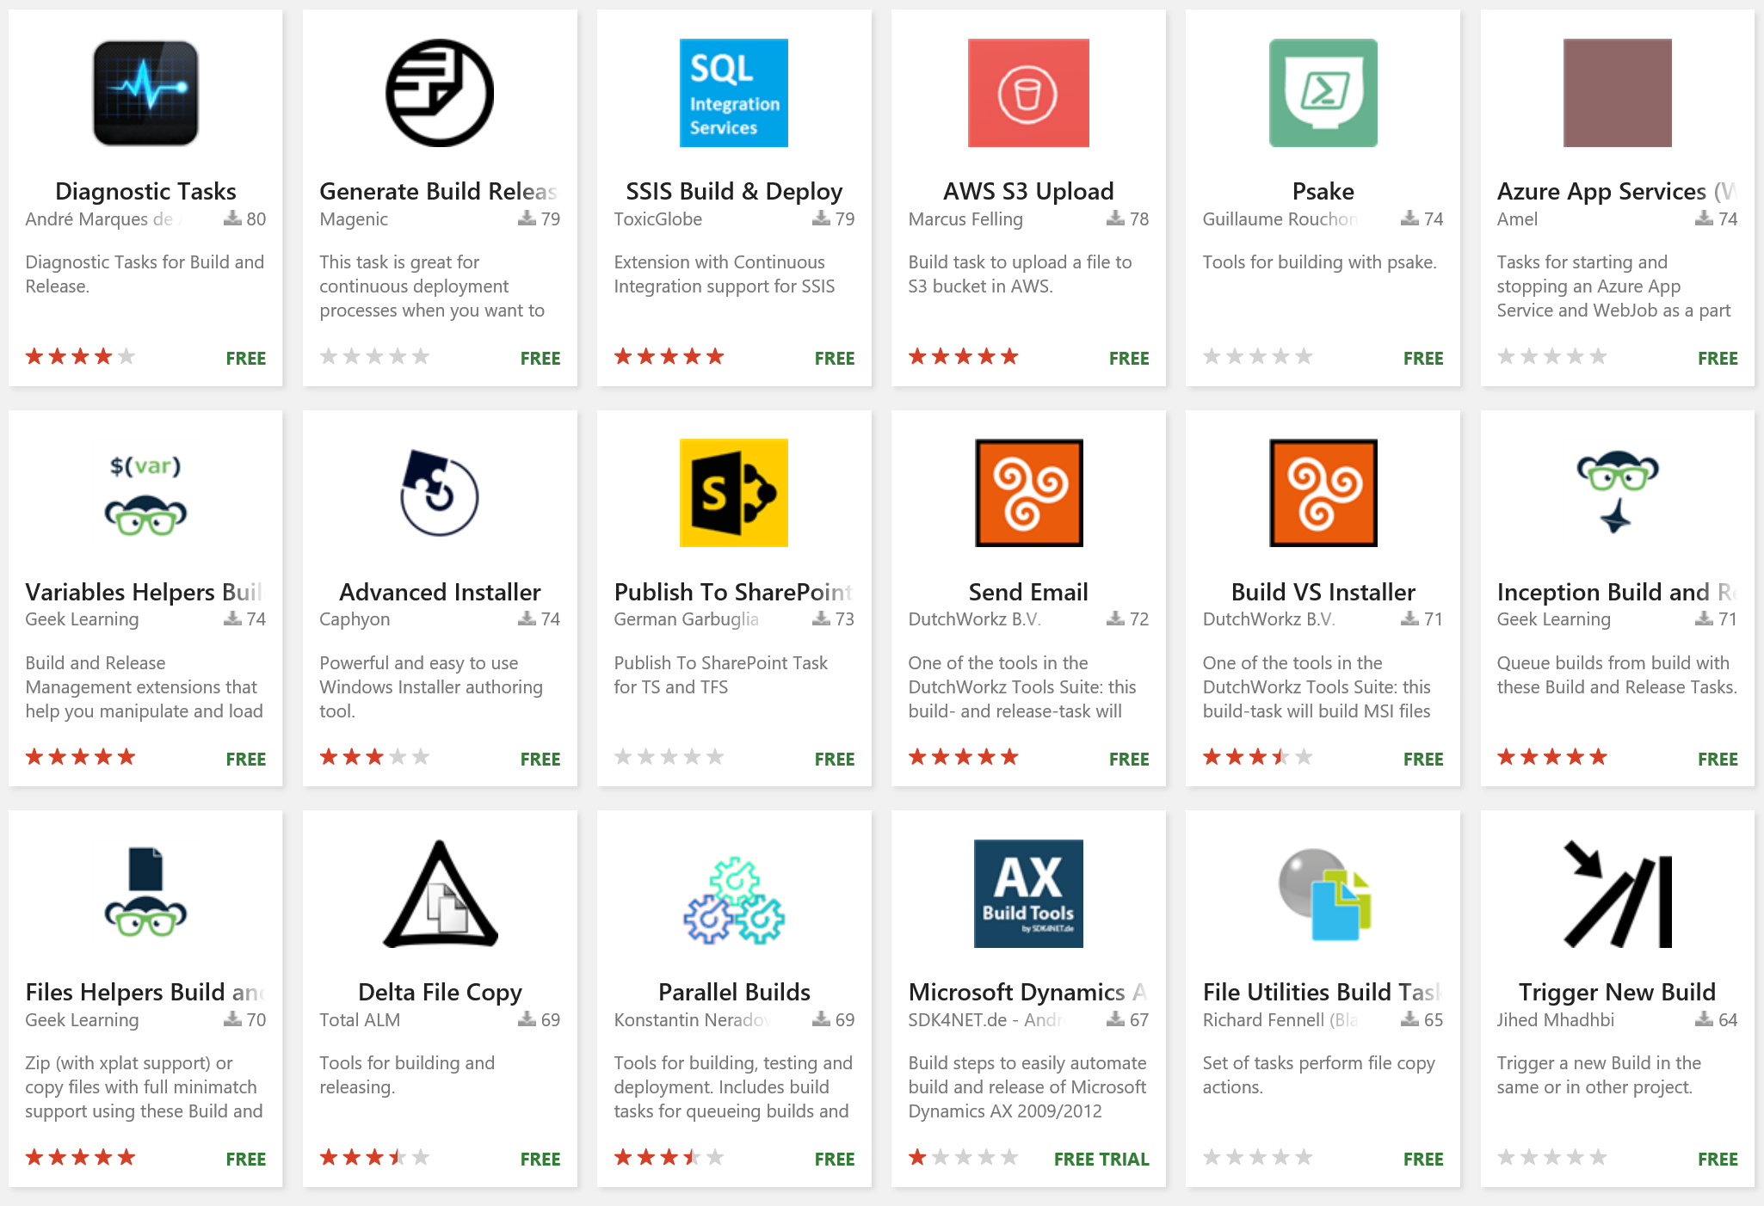
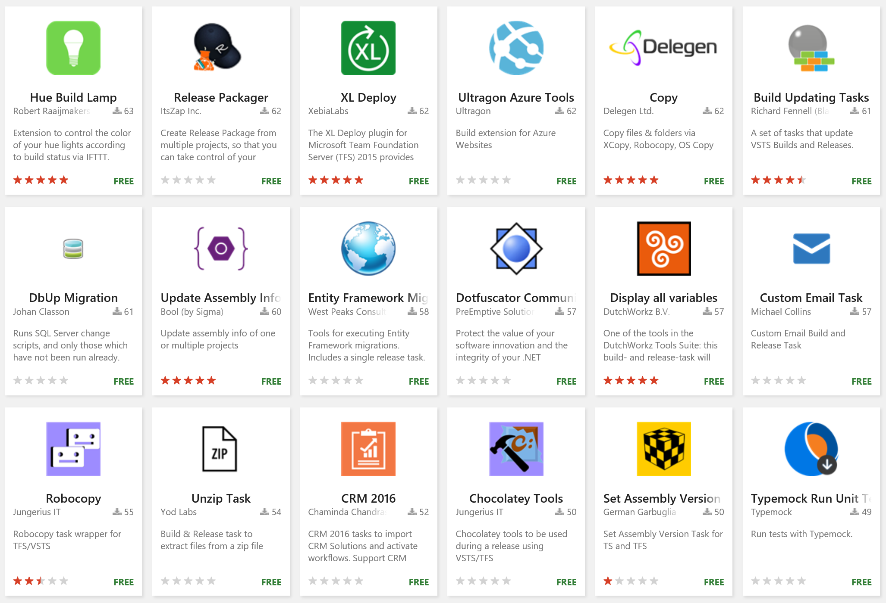
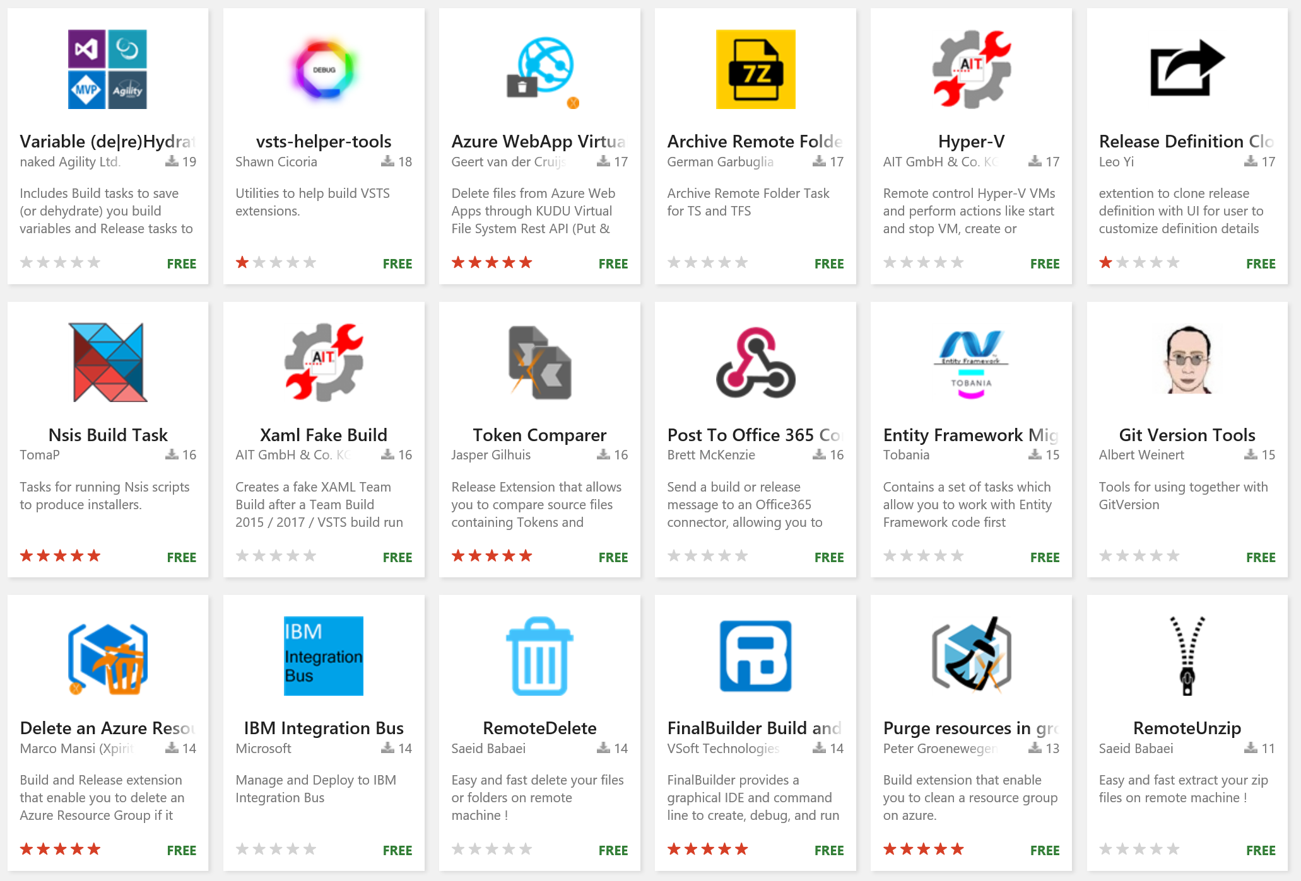
Extensions
Over 500 extensions for Azure DevOps ad TFS covering all elements of the project lifecycle and integrations with popular commercial and open source tooling

Slide 11








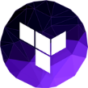
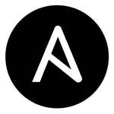
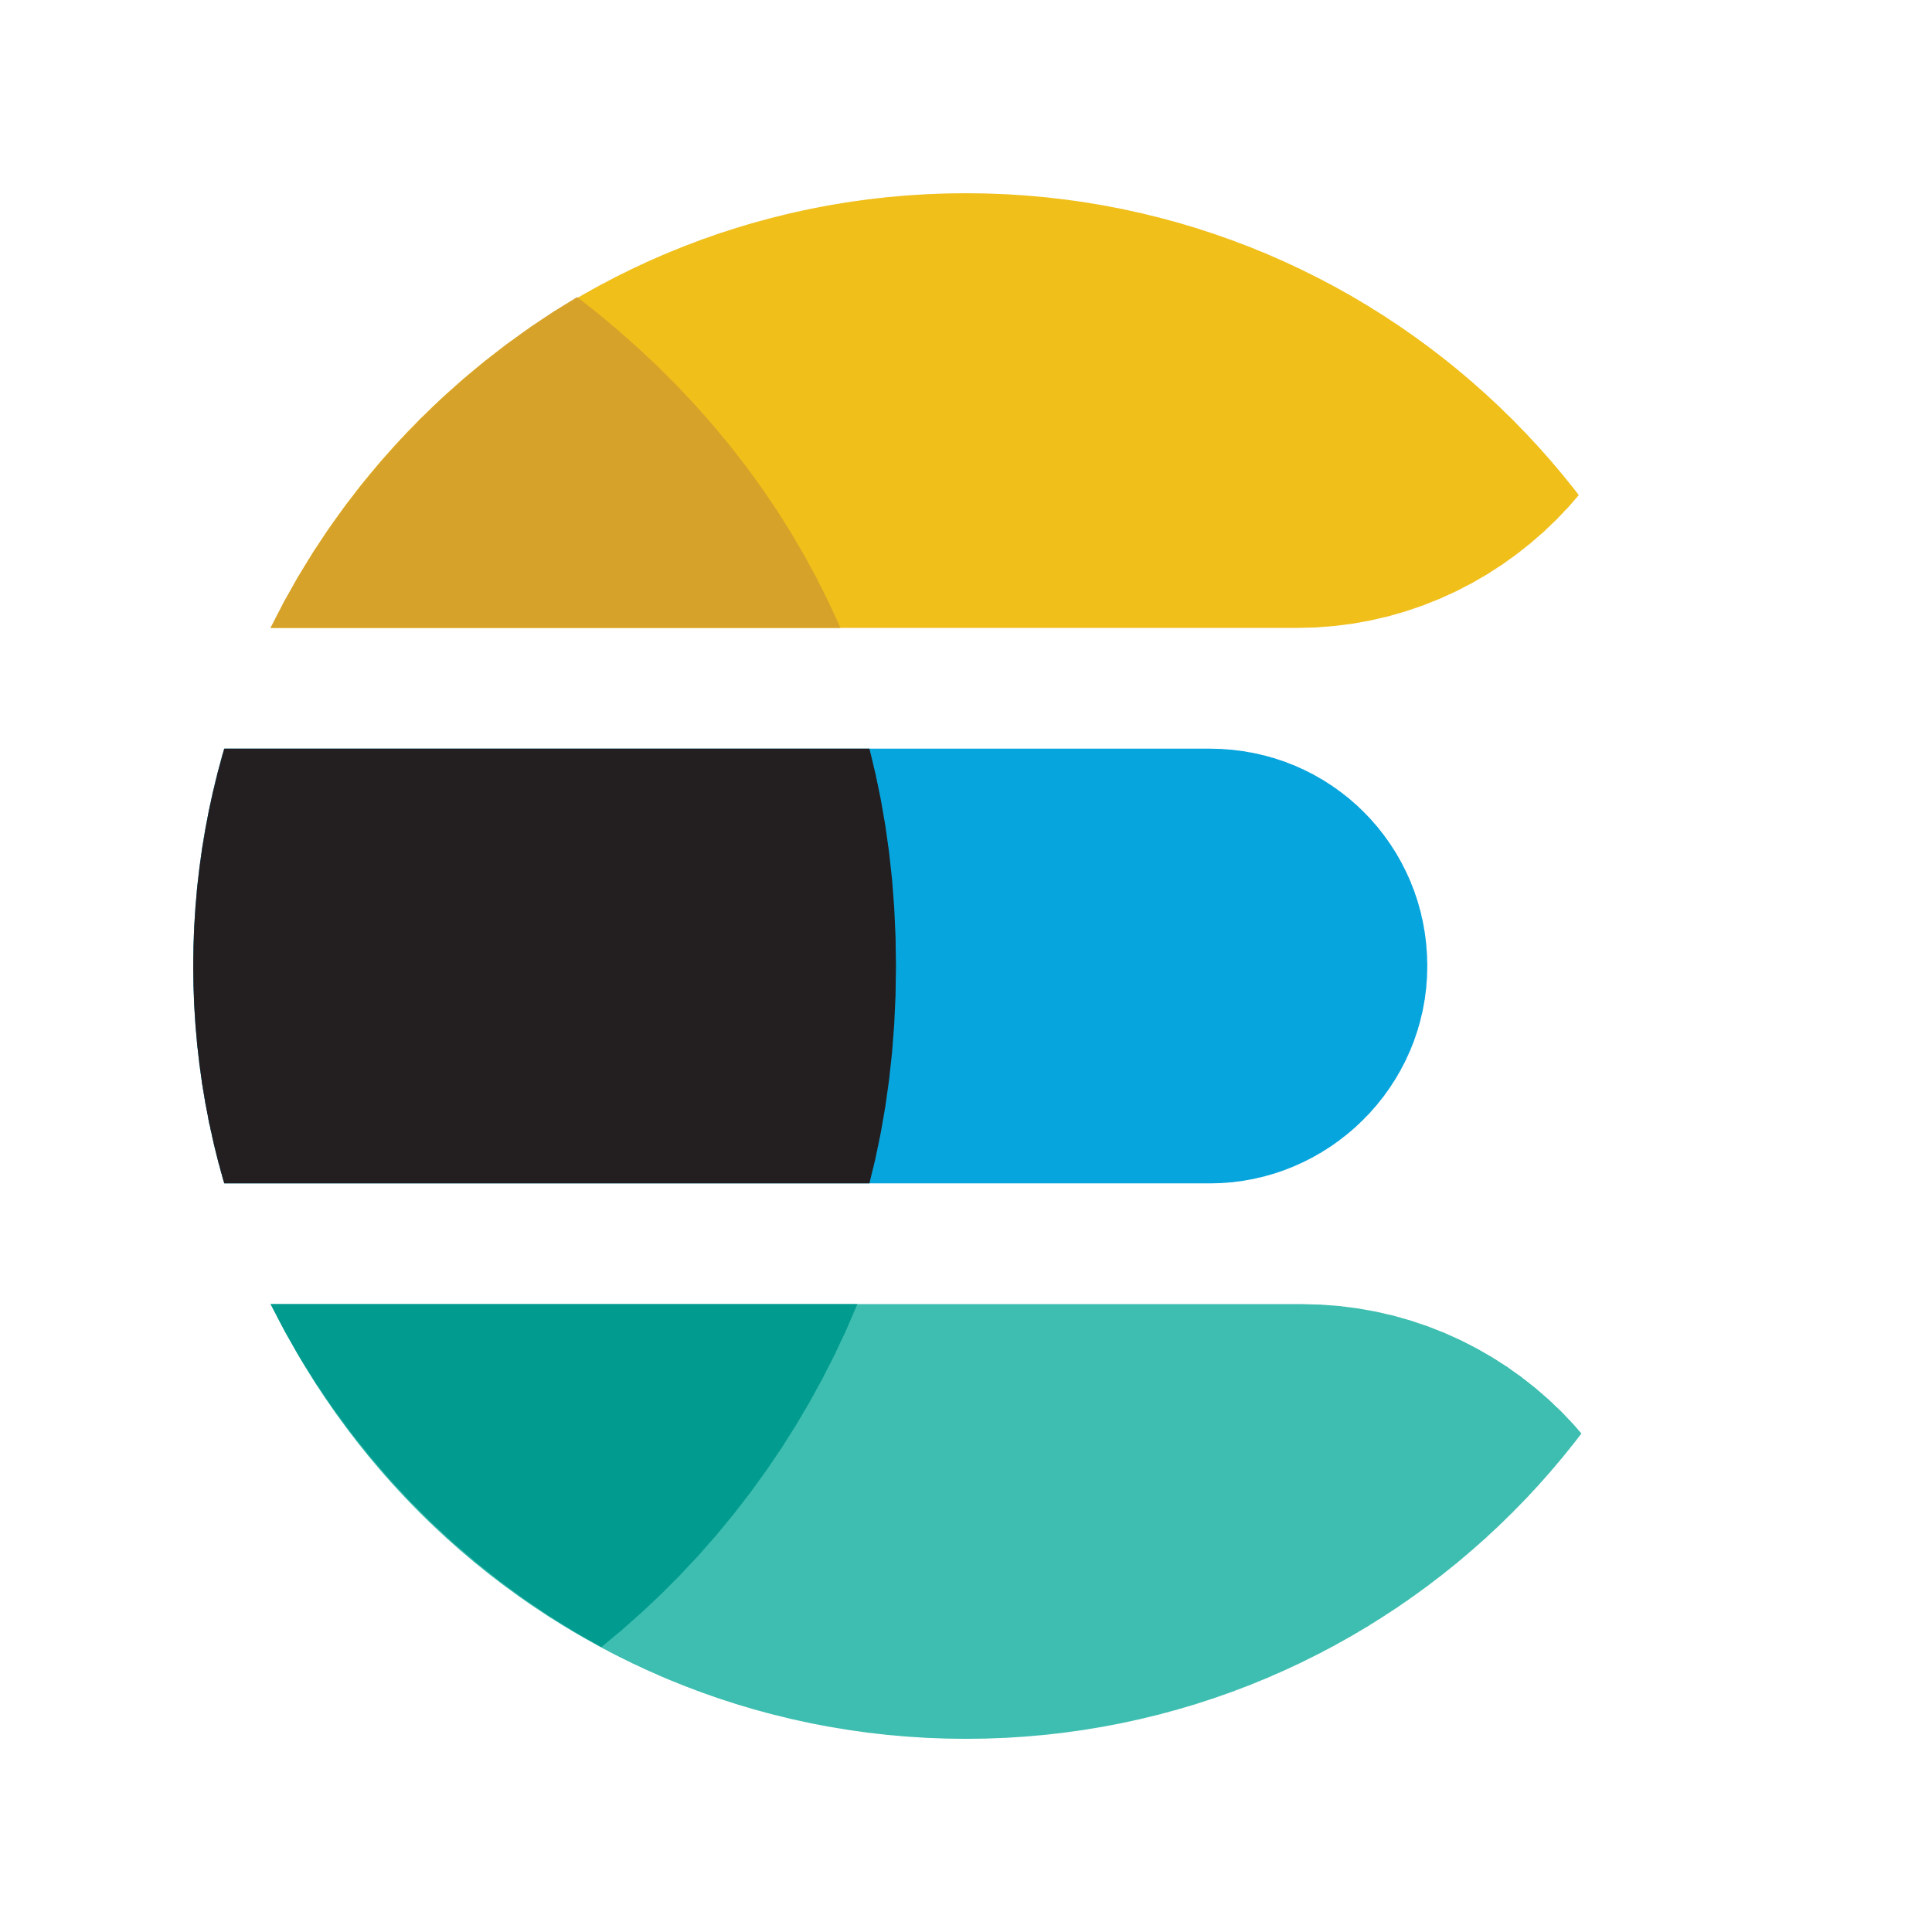

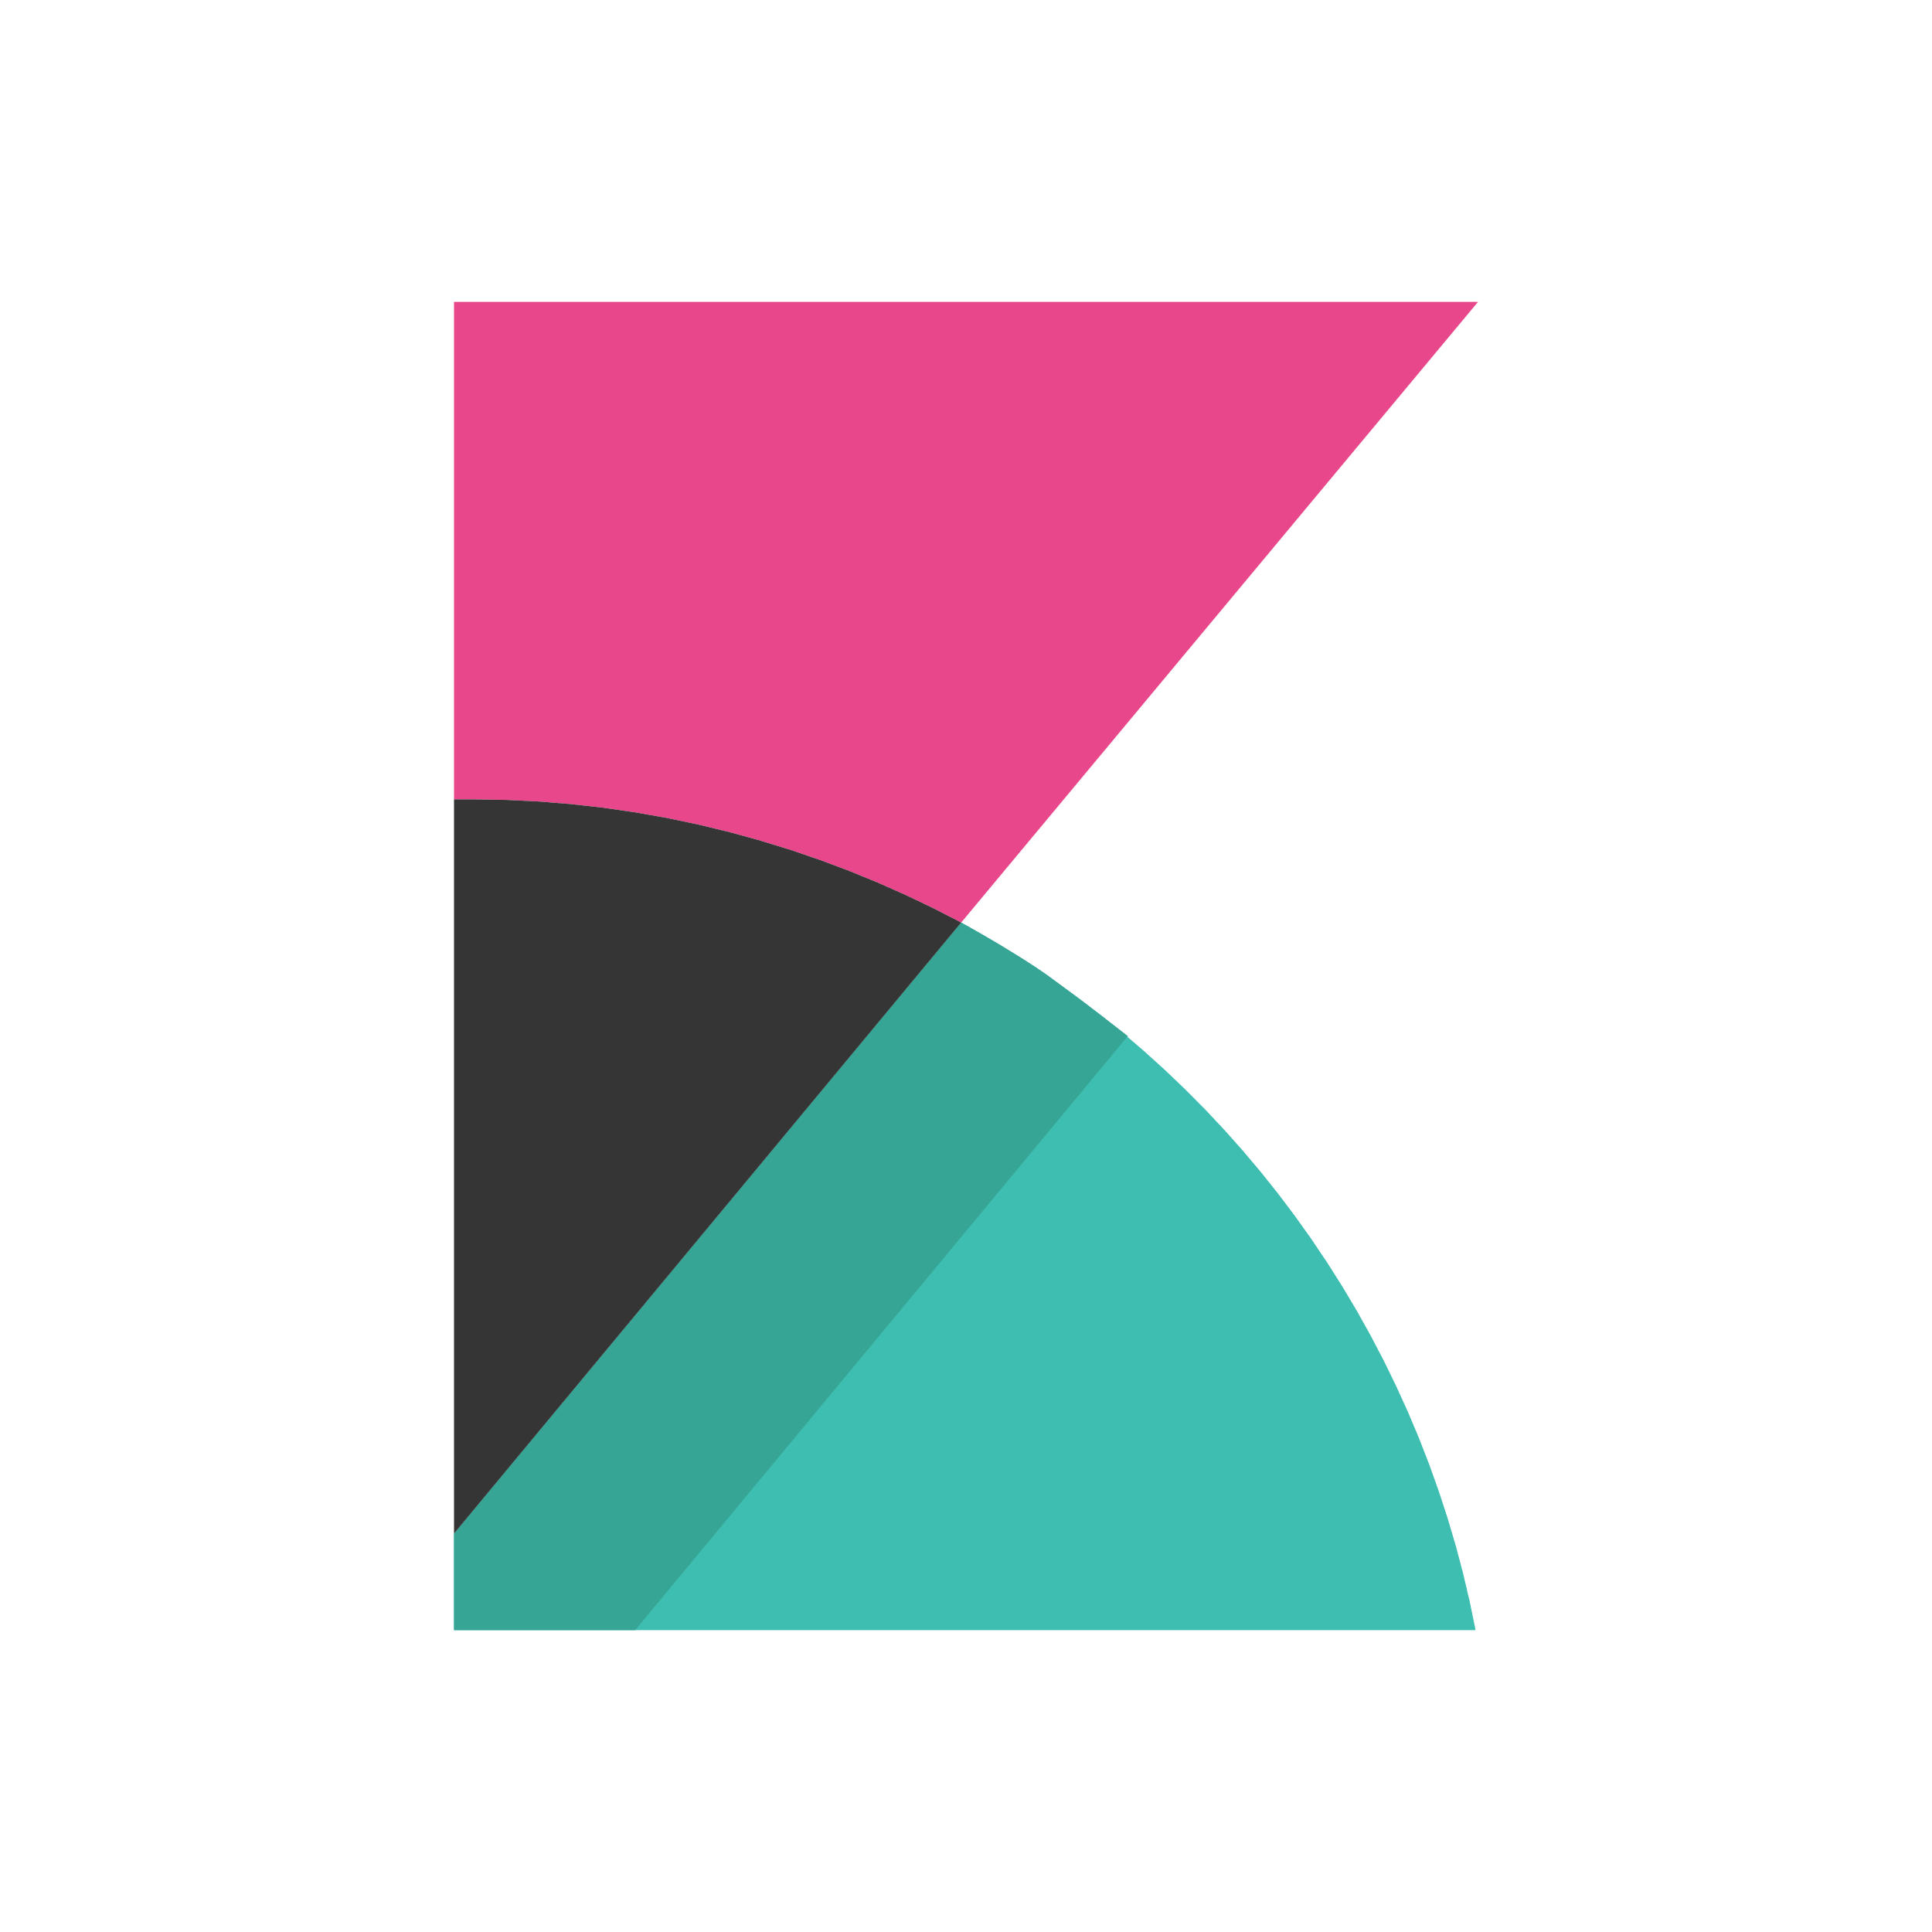
DevOps on Azure framework
Plan and track
Code
Build and test
Deploy
Operate
Monitor
Boards
(Azure DevOps)
Repos
(Azure DevOps)
Pipelines & Test Plans
(Azure DevOps)
Artifacts & Pipelines
(Azure DevOps)
Policy
Application
Insights
GitHub
Trello
GitHub
Jenkins
Terraform
Ansible
ELK Stack
Notes:
Deliver continuous innovation faster and more reliably with DevOps and Microsoft Azure.
Azure DevOps provides a fully integrated set of enterprise DevOps services covering the entire DevOps lifecycle. You can use all the Azure DevOps services, or choose just what you need to complement your existing workflows. Azure DevOps is comprised of:
Azure Boards allows you to track work with configurable Kanban boards, interactive backlogs, and powerful planning tools. Combined with the Azure DevOps suite of services, it provides traceability through the entire pipeline, from work item tracking, to code commit, builds and right through deployments.
Azure Repos provide flexible and powerful Git hosting with effective code reviews, start free and scale to unlimited git repositories for all your ideas.
Azure Pipelines allows you to build, test and deploy in any language, to any cloud – or on-premises. Run builds and tests in parallel on Linux, macOS, or Windows, and deploy containers to individual hosts or Kubernetes
Azure Test Plans enables you to improve your overall code quality with manual and exploratory testing tools for your apps.
Azure Artifacts allows you to share Maven, npm, and NuGet packages from public and private sources with your entire team. Integrate package sharing into your CI/CD pipelines in a way that's simple and scalable.
You can also use GitHub Enterprise or GitHub Business cloud for the management of source code, with direct integration into Azure Pipelines to provide an end-to-end solution that leverages the power and familiarity of GitHub, the largest open source community in the world. GitHub is also an open platform supporting a large ecosystem of integrations beyond Azure, that are easily available from the GitHub marketplace.
Azure is open – so If you've already made tooling choices such as Jenkins, Terraform, Ansible or Chef, we provide clear guidance and documentation to help you get started on Azure, fast.
If you’ve made choices in some areas, but have gaps in others, you can take advantage of Azure Pipelines to orchestrate and supplement your end-to-end DevOps toolchain.
Regardless of your toolchain choice, take advantage of the reliable and integrated security, monitoring & management capabilities of the Azure platform such as Azure Policy, Azure Monitor and Application Insights – spend less time fighting fires and more time meeting business requirements

Slide 12

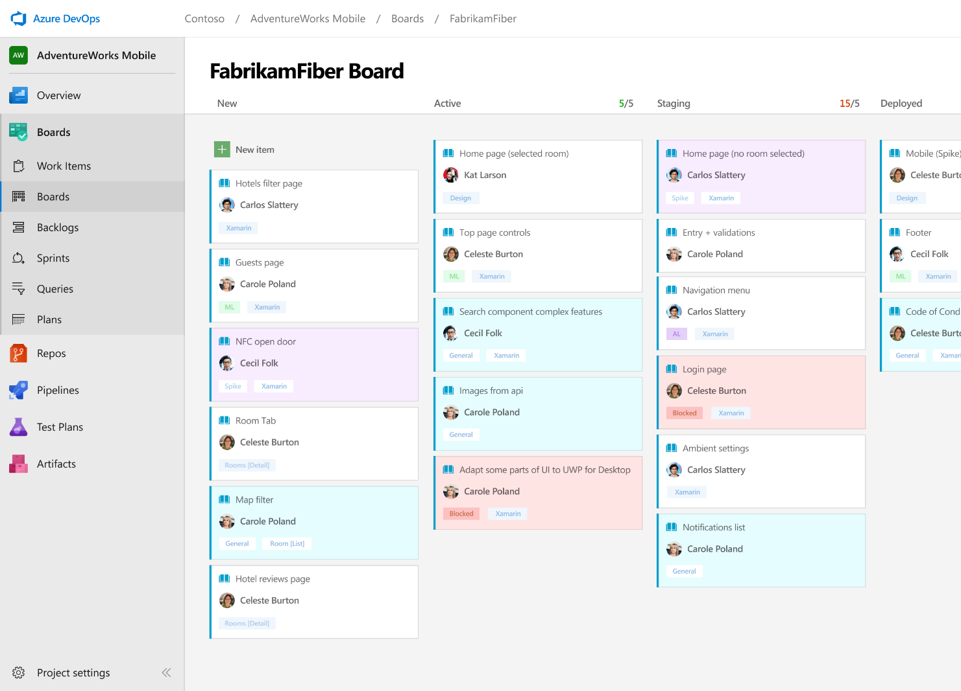



Azure Boards
Track work with Kanban boards, backlogs, team dashboards, and custom reporting
Connected from idea to release
Track all your ideas at every development stage and keep your team aligned with all code changes linked directly to work items.
Scrum ready
Use built-in scrum boards and planning tools to help your teams run sprints, stand-ups, and planning meetings.
Project insights
Gain new insights into the health and status of your project with powerful analytics tools and dashboard widgets.
➔
https://azure.com/devops
Notes:
Combine Kanban boards and drag-and-drop sprint planning with comprehensive traceability and reporting for the perfect home for all your ideas–big and small.

Slide 13
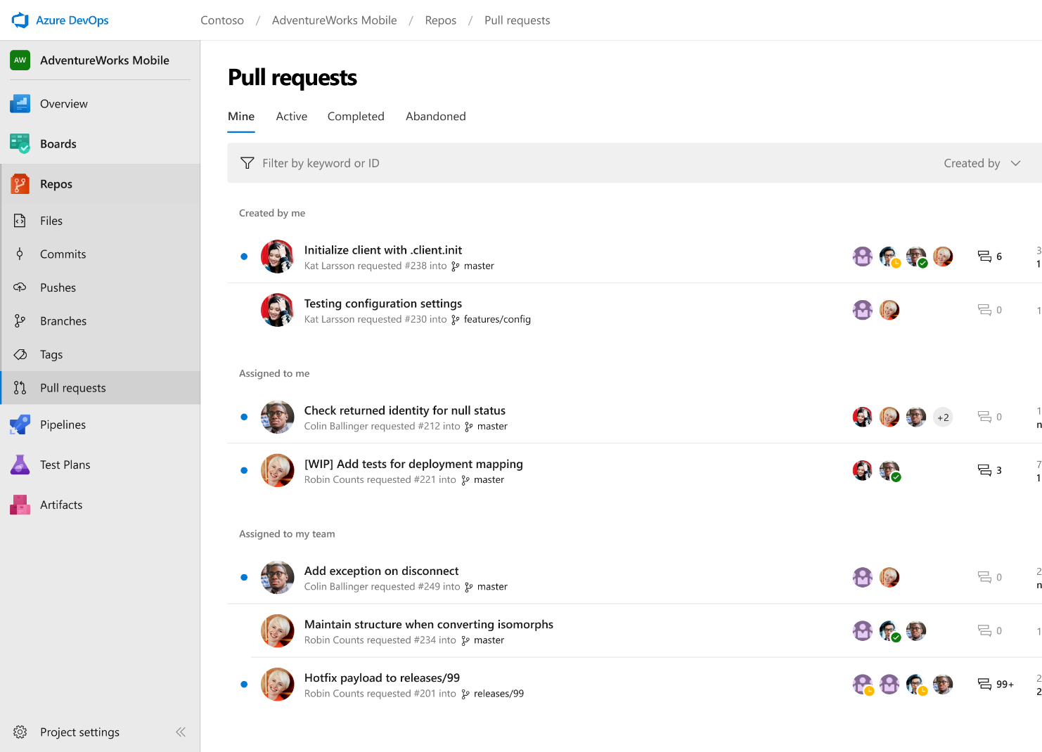



Azure Repos
Unlimited private Git repo hosting and support for TFVC that scales from a hobby project to the world’s largest Git repositories
Works with your Git client
Securely connect with and push code into your Git repos from any IDE, editor, or Git client.
Web hooks and API integration
Add validations and extensions from the marketplace or build your own using web hooks and REST APIs.
Semantic code search
Quickly find what you’re looking for with code-aware search that understands classes and variables.
➔
https://azure.com/devops
Notes:
Collaborate on code changes with threaded discussion and continuous integration for each change. Use forks to promote collaboration with Inner Source workflows.

Slide 14

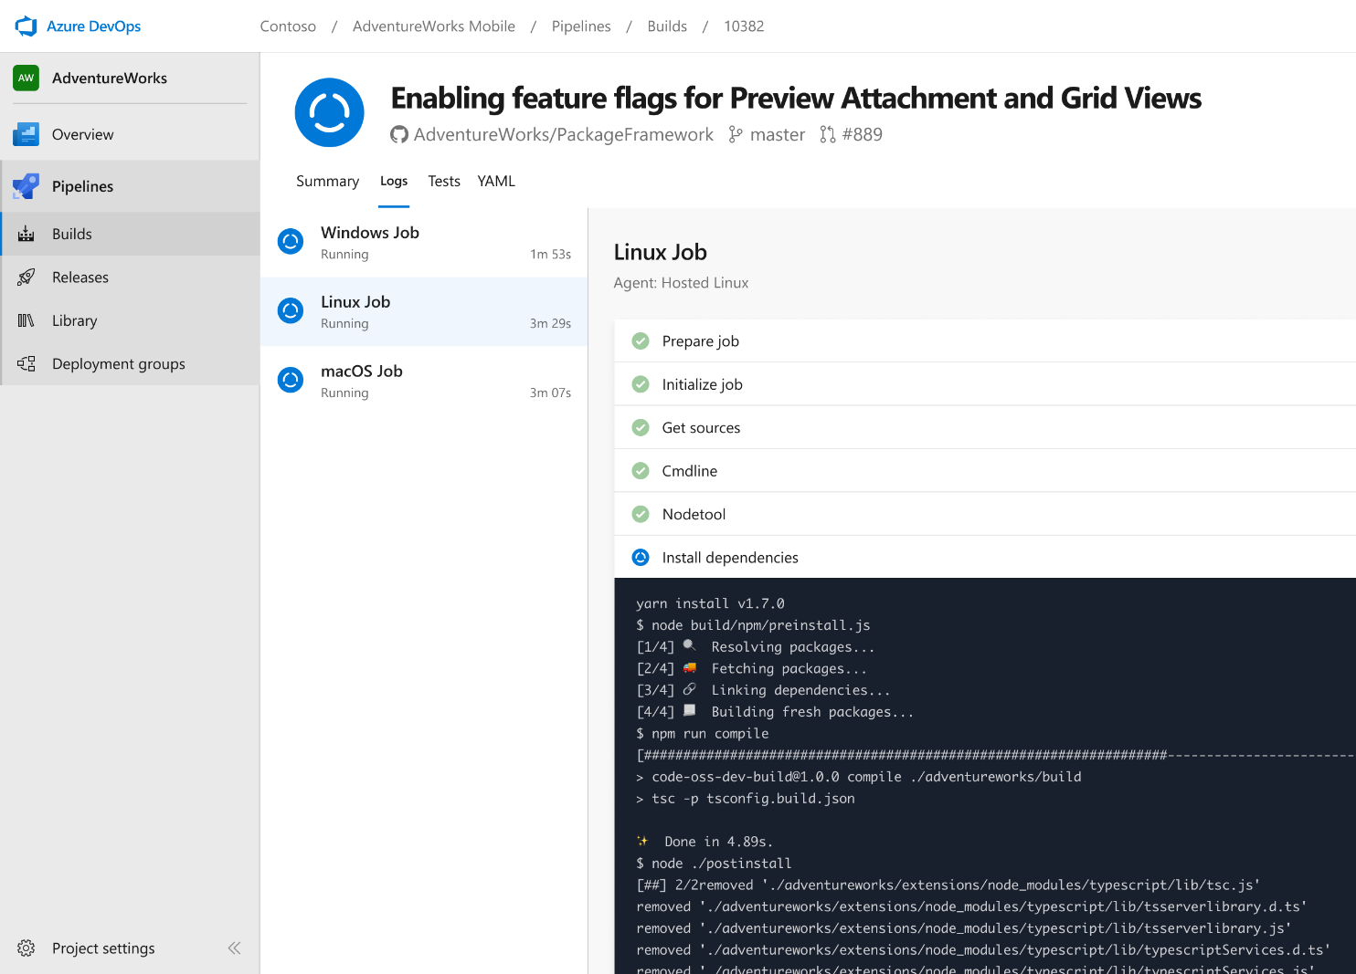


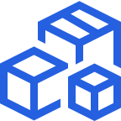

Azure Pipelines
Cloud-hosted pipelines for Linux, Windows and macOS, with unlimited minutes for open source
Any language, any platform, any cloud
Build, test, and deploy Node.js, Python, Java, PHP, Ruby, C/C++, .NET, Android, and iOS apps. Run in parallel on Linux, macOS, and Windows. Deploy to Azure, AWS, GCP or on-premises
Extensible
Explore and implement a wide range of community-built build, test, and deployment tasks, along with hundreds of extensions from Slack to SonarCloud. Support for YAML, reporting and more
Containers and Kubernetes
Easily build and push images to container registries like Docker Hub and Azure Container Registry. Deploy containers to individual hosts or Kubernetes.
Best-in-class for open source
Ensure fast continuous integration/continuous delivery (CI/CD) pipelines for every open source project. Get unlimited build minutes for all open source projects with up to 10 free parallel jobs across Linux, macOS and Windows
➔
https://azure.com/pipelines
Notes:
Azure Pipelines is the perfect launchpad for your code – automating your builds and deployments so you spend less time with the nuts and bolts and more time being creative

Slide 15
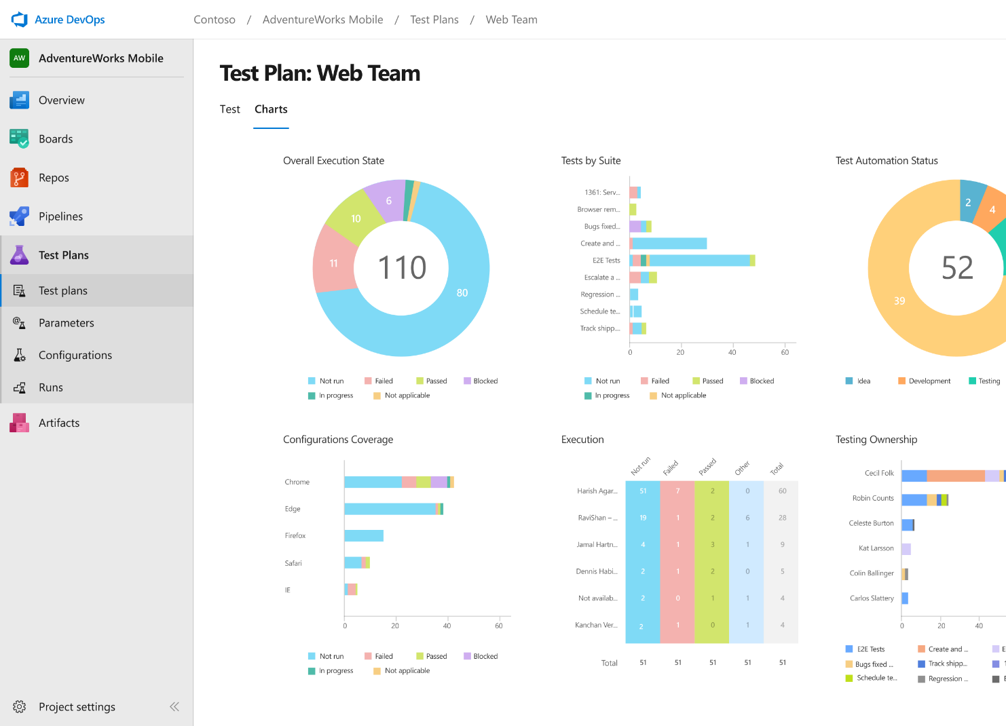
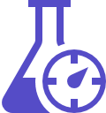


Azure Test Plans
Get end-to-end traceability. Run tests and log defects from your browser. Track and assess quality throughout your testing lifecycle.
Capture rich data
Capture rich scenario data as you execute tests to make discovered defects actionable. Explore user stories without test cases or test steps. You can create test cases directly from your exploratory test sessions.
Test across web and desktop
Test your application where it lives. Complete scripted tests across desktop or web scenarios. Test on-premises application from the cloud and vice-versa.
Get end-to-end traceability
Leverage the same test tools across your engineers and user acceptance testing stakeholders. Pay for the tools only when you need them.
➔
https://azure.com/devops
Notes:
Collaborate on code changes with threaded discussion and continuous integration for each change. Use forks to promote collaboration with Inner Source workflows.

Slide 16
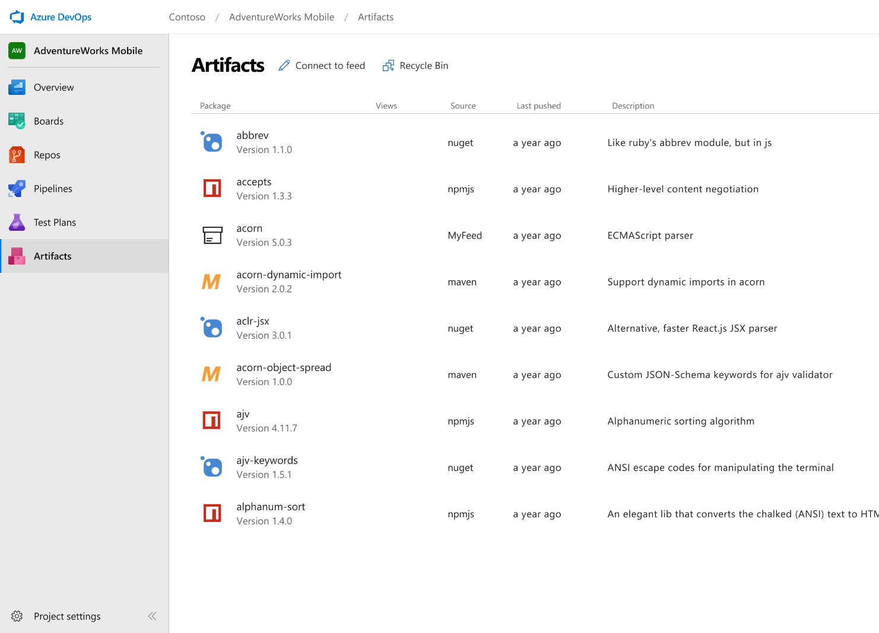



Azure Artifacts
Create and share Maven, npm, and NuGet package feeds from public and private sources – fully integrated into CI/CD pipelines
Manage all package types
Get universal artifact management for Maven, npm, and NuGet.
Add packages to any pipeline
Share packages, and use built-in CI/CD, versioning, and testing.
Share code efficiently
Easily share code across small teams and large enterprises.
➔
https://azure.com/devops
Notes:
Collaborate on code changes with threaded discussion and continuous integration for each change. Use forks to promote collaboration with Inner Source workflows.

Slide 17

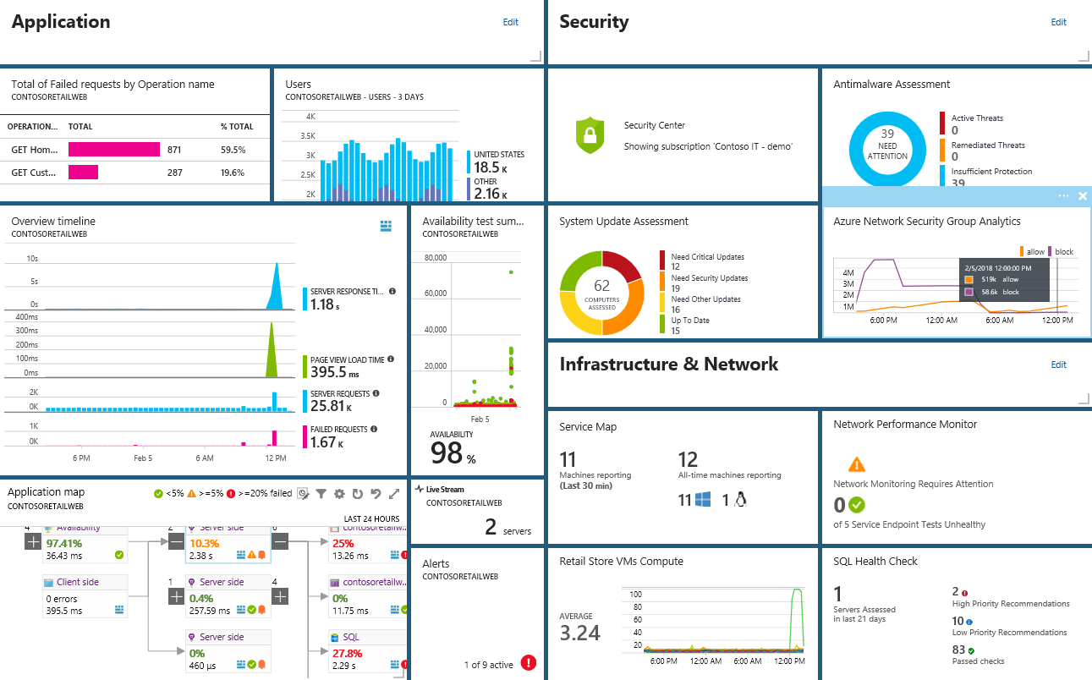
Smarter Insights, Faster
Azure Monitor, Application Insights & Log Analytics
Pre-defined solutions with smart thresholds
Visualize data in intuitive and customizable dashboards
Separate the signal from the noise and accelerate root-cause analysis
Integrate your existing processes & tools like Service Now
Notes:
Azure’s monitoring solutions provide pre-defined solutions with smart thresholds and intuitive dashboards so you can start getting insights straight away
Azure Monitor provides metrics for all Azure infrastructure, building upon that you can leverage both Log Analytics and Application Insights to gain greater insights into your Infrastructure and Applications respectively – leveraging Azure to simplify this into standardized dashboards for both your Developer and your Operations teams
Spend less time separating the signal from the noise and accelerate you root cause analysis
You can also automate and integrate into your existing service desk platforms such as Service Now
------ (additional product context) ------
Monitor your cloud health with Log Analytics
Collect and store your data from any source
Easily collect, store, and analyze your systems and operational data from any source, both on-premises and in the cloud.
Collect data from a wide range of sources including virtual machines, storage accounts, activity logs, Windows, Linux Servers, Java, .NET, legacy and modern apps.
Centrally store activity logs, network logs, infrastructure metrics, app data points, diagnostics logs and alerts.
Gain deep operational insights
Understand CPU disk and memory utilization for your virtual machines.
Get a comprehensive view of applications and network dependencies across multiple virtual machines to perform root-cause analysis more quickly.
Track configuration changes, system updates, and malware status to improve security & compliance.
Visualize data in intuitive and customizable dashboards.
Find the information you need quickly using interactive queries and full-text search.
Detect, diagnose and fix issues quickly
Get notifications and alerts with rich diagnostic information so you can always stay on top of the issues.
Separate the signal from the noise and accelerate root-cause analysis across platforms using advanced analytics including machine learning algorithms.
Automate the implementation of recommended fixes so you can address issues quickly.
Integrate with customer service systems such as your ticketing tool to speed up implementation of fixes.

Slide 18

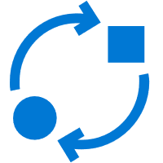

Our journey to DevOps
People
Process
Tools
PM, Dev, Test roles
Personal offices
Deep hierarchy
20+ team sizes
4-6 month milestones
Features shipped once a year
Success is install numbers Long planning cycles
Secret roadmap
100 page spec documents
Proprietary SC, TFSVC
Feature branches
Proprietary toolchain
PM & engineering roles only
Team rooms
Flattened hierarchy
8-12 team sizes
3-week Sprints
Features shipped every Sprint
User satisfaction determines success Continuous planning & learning
Publicly shared roadmap
Mockups in PPT
Git
Everyone in master
Azure DevOps
Notes:
Azure DevOps is built based on our experiences from our own journey to DevOps.
Since 1975, Microsoft has done development a certain way – the waterfall way.
But circa 10 years ago, we saw our business rapidly changing around us – we had to turn our ship around.
Nimble and agile competitors were beginning to eat our lunch.
We quickly realized that our transformation to DevOps would have broad organizational impact.
Every DevOps conversation needs to focus on people, processes and tools equally, otherwise the transformation will fail.
Our DevOps journey began with gradually changing the way we work.
Over time, we were able to introduce broad mindset changes that everybody in our organization now actively embraces and lives every day.
Today, all of Microsoft has adopted DevOps.

Slide 19
DevOps at Microsoft
Azure DevOps is the toolchain of choice for Microsoft engineering with over 90,000 internal users
➔
https://aka.ms/DevOpsAtMicrosoft
372k
Pull Requests per month
4.4m
Builds per month
5m
Work items viewed per day
85,000
Deployments per day
2m
Git commits per month
500m Test executions per day
500k
Work items updated per day
Data: Internal Microsoft engineering system activity, August 2018
Notes:
Enterprise scale

Slide 20


What’s DevOps allows to achieve…
46x Deployment
Frequency
2 555x Faster Lead Time For Changes
Faster
Time to Market
DevOps
$
Increased
Revenue
7x Lower Change
Failure Rate
2 604x Faster Mean
Time to Recover
Source: 2018 Accelerate: State of DevOps: Strategies for a New Economy." N. Forsgren, J. Humble, G. Kim. DevOps Research and Assessment (DORA)
Notes:
Change Lead Time, also known as just lead time or Mean Time To Change, is defined as follows: The time it takes for a bug fix, new feature or any other change to go from idea to deployment to production

Slide 21
Azure DevOps Demo
#AzureDevOps

Slide 22
Application Modernization

Slide 23



Business is powered by applications
External-facing Applications
Line of Business Applications
DATA
Internal Applications
Notes:
Every modern business is powered by applications.
That is why you can hear people say that every company is a software company.
Every company runs many different applications that are essential for their business – internal business applications (data entry, business intelligence, procurement, legal, CRM, ERP) but also external-facing applications for customers and partners (company web site, customer self-service portal, e-commerce sites, mobile apps for products and services).
Both external-facing applications and internal business applications in turn are connected to and access line of business applications – those mission-critical business systems that form the bedrock of every company – SAP, CRM, mainframe systems that run factories or fulfillment centers, HR, payroll and so on.
And then, there's data.
Every single application in an organization works with data, consumes data and – in turn - generates data.
Today, every business collects tremendous amounts of data - and the challenge is how to turn this treasure trove of unstructured information into actionable insights and intelligence.

Slide 24



Application layers
Code
Data + Intelligence
Infrastructure
Notes:
At a very high level, applications consist of three layers.
The first layer is the application code – functionality and business logic.
Then, there’s the data that the application consumes and generates – every application works with data, and that data can come from many different sources.
Finally, there’s the physical or virtualized infrastructure the application runs on – servers or virtual machines, networking and so on.
When you are looking to modernize an application, you will need to look at all these layers individually.
However, not all layers need to be treated the same way.
You might, for example, decide to keep your data on-premises for security and governance reasons and move application code and infrastructure to the cloud – a common hybrid scenario that addresses specific requirements in regulated industries.

Slide 25

Challenges
Keeping up with the speed of business
Code
More resilient and scalable applications
Adding new features and functionality without taking applications down
Future-proof applications
Data
Application Delivery
Data growth and data silos
Incongruent data types
Performance constraints
Complexity of solutions
Rising data maintenance costs
Security issues and data breaches
Shorter release cycles
Improved software quality
Responding faster to bugs and security incidents
Learning from real usage to continuously improve applications
Infrastructure
Heterogeneous workloads
Hybrid deployments
Security and management
Continuous monitoring
Cost management
Notes:
In many cases, companies already have prior application investments that appear outdated, inflexible or are simply not up to the task because the technology and business environment has changed since they were built.
Many IT budgets are consumed by maintaining existing apps and resources and staying current with upgrades and migrations can deplete funding and resources before business benefits are realized.
If that is the case, such applications need to be re-vitalized and modernized to keep up with the current speed of business.
The growing requirements of our modern, digital business world can be a challenge for older applications – but there is a way to future-proof existing applications.

Slide 26


Are your applications ready?
Today
Future
Application silos, built in isolation
Limited set of platforms and form factors
Overabundance of data
Servers and infrastructure to manage
Upfront capacity planning, fixed scale
Multi-channel applications, covering all touchpoints
Many platforms, devices and form factors
Data-driven intelligence in applications
Focus on application functionality, not infrastructure
Elastic, unlimited scale
Notes:
As the business world moves into the digital space to meet the next generation of customers, employees and partners, create new efficiencies, and compete globally, organizations can’t view applications the same way as before – they must take them to the next level.
Are your applications ready for this new tomorrow?

Slide 27
Others reasons to modernize apps
Security
Scale
Innovation
Resolve security challenges
Safeguard reputation
Reach people across multiple platforms
Customize app experiences
Agility
Scale more effectively
Tailor LOB apps
Changing Skillset
Improve extended workflows
Reduce IT Maintenance
Experiment more quickly
Migrate legacy apps
Notes:
Here are some of the situations that the App Modernization Advanced can help with. It’s ideal if you want to:
Speed/Agility – reduce time-to-market and cost ((example includes…)
Drive market innovation and agility with the ability to experiment with different business models quickly and more easily.
Streamline operations by improving extended workflows (i.e., with suppliers and partners).
Scale – customer reach and engagement (example includes…)
Deal with increasingly complex multi-platform environments by delivering innovative and scalable cloud solutions that help organizations engage with stakeholders more effectively.
Security – protect data
Help protect reputation and help make sure services are constantly available with high levels of performance and availability.
Help resolve security challenges that stem from mixing Internet-facing workloads in corporate datacenters.
Innovation – drive innovation and market differentiation (examples include…)
Differentiate yourself with tailored LOB apps.
Customize app and digital experiences for different personas and devices
Developer demographic – skill sets changing
Reduce IT maintenance and improve flexibility by migrating LOB apps originally built on Windows Server 2003 and SQL Server 2005 before end-of-life.
Update legacy applications with more modern, cloud-based solutions that provide greater agility.

Slide 28
The Journey to the Cloud
Migrate
Application Modernization
SaaS
Rehost
Refactor
Rearchitect
Rebuild
Replace
Source: Gartner: “Developing a Public Cloud IaaS Adoption and Migration Framework” published March 2017
Notes:
!Speaker note!: You can introduce the last phase: SaaS, Replace, but we won’t cover that step in detail the rest of the deck.
1) Other options:
- Retain on-premises
Retire
2) SaaS refers to Commercial off-the-shelf (COTS), the purchase of packaged solutions which are then adapted to satisfy the needs of the purchasing organisation, rather than the commissioning of custom made solutions.

Slide 29
The Journey to the Cloud
Migrate
Application Modernization
Rehost
Refactor
Rearchitect
Rebuild
On-Premises
Infrastructure Platform
IaaS
Infrastructure Platform
“lift & shift”
Containers
Container Platform
PaaS/Serverless
Application Platform
Notes:
!Speaker note!: in this session, we will focus on the App modernization. (not going into Replace)
Source: Gartner: “Developing a Public Cloud IaaS Adoption and Migration Framework” published March 2017

Slide 30



The journey to the cloud
IaaS/VM/Compute
Platform as a Service
Serverless
Own your home
Bed and breakfast​
Hotel
Notes:
Azure is the home for all your applications.
For some applications, you want full control over everything – infrastructure, data and code.
For these applications IaaS is the way to go.
IaaS is like owning your own home – you can do whatever you want, but you also have to do maintenance and upkeep and if something breaks you’ll have to find a way to fix it yourself.
For other applications, you just want to move in and run them as efficiently as possible, without thinking about plumbing and wiring.
PaaS is like a bed and breakfast for applications.
You move in and things are handled for you - you just lean back and enjoy your breakfast.
Serverless is the luxury version of that – with serverless, you do not even think about the infrastructure behind the scenes, you just use a service and it takes care of everything, allowing you to focus on what matters to you – building functionality and writing great code.
It’s like a luxury hotel for your application where guests get what they want, every time, no fuss no muss.
It’s not an either-or choice – you can own a home and stay in a hotel or B&B at the same time – just like you can run some of your cloud apps in IaaS, some in PaaS and some using serverless – it’s all up to you.

Slide 31
Application Modernization in a nutshell
rehost
refactor
rearchitect
Rebuild/ build new
Description
Redeploy as-is to cloud
Minimally alter to take better advantage of cloud
Materially alter/decompose application to services
New code written with cloud native approach
Reduce Capex
Free up datacenter space
Quick cloud ROI
Faster, shorter, updates
Code portability
Greater cloud efficiency (resources, speed, cost)
App scale and agility
Easier adoption of new cloud capabilities
Mix technology stacks
Accelerate innovation
Build apps faster
Reduce operational cost
Drivers
PaaS
Containers
PaaS
Serverless
Microservices
Technologies
IaaS
Results
IaaS: 435% ROI, 73% reduction in datacenter footprint and 83% reduced IT outsourcing cost.¹
PaaS: 466% ROI, 80% time saved, 5.91M NPV, 50% faster deployments.¹
Container: 13x more releases, 10x cost reduction, 65% faster developer onboarding, 62% better availability. ²
Notes:
Gartner: Developing a Public Cloud IaaS Adoption and Migration Framework, published March 2017.

Slide 32








App modernization options
IaaS
PaaS
Serverless
Azure Function
Azure WebApps
Container in WebApp
VM
Azure Logic Apps
Azure AKS
Azure Batch
VM Scale Set
ACI
Azure Service Fabric
Azure SF Mesh
Control
Agility and Productivity
Notes:
While lift and shift to IaaS is a viable path to the cloud for many applications, this route will not unlock all possible cloud benefits.
If you are looking to get the most from the cloud and tap into advanced capabilities like improved resiliency, global scale or maximum agility, cloud native applications are built from the ground up and optimized for cloud scale and performance.
They are based on microservices architectures, use managed services, and take advantage of continuous delivery to achieve reliability and faster time to market.
Azure is a turn-key delivery platform for modern applications that offers a broad range of managed services for all application scenarios, allowing you to choose the best approach for your cloud-native applications.
One way of evaluating the different options is to look at productivity versus infrastructure control and the level of infrastructure abstraction.
If you want to focus on code and application functionality first, without having to think about the underlying infrastructure, then options like serverless or Azure App Service can be right for you – here, the underlying infrastructure is handled by Microsoft, saving time and allowing developers to focus exclusively on what’s most important.
If, on the other hand, you want to keep tighter control over infrastructure management then options like containers and Kubernetes might be the best choice for you.

Slide 33




A turn-key platform for Application Modernization
Orchestration (Kubernetes)
Microservices
Web Apps
Event-driven
Functions
Infrastructure abstraction
< Control
Productivity >
Notes:
While lift and shift to IaaS is a viable path to the cloud for many applications, this route will not unlock all possible cloud benefits.
If you are looking to get the most from the cloud and tap into advanced capabilities like improved resiliency, global scale or maximum agility, cloud native applications are built from the ground up and optimized for cloud scale and performance.
They’re based on microservices architectures, use managed services, and take advantage of continuous delivery to achieve reliability and faster time to market.
Azure is a turn-key delivery platform for modern applications that offers a broad range of managed services for all application scenarios, allowing you to choose the best approach for your cloud-native applications.
Containerize your applications and let Azure managed services handle container orchestration, provisioning, upgrading, and scaling cluster resources based on demand.
Simplify the development of distributed cloud applications and take advantage of an enterprise-grade microservices platform with built-in security and autoscaling.
Build cloud-native apps without provisioning and managing infrastructure using a fully managed platform where scaling, availability, and performance are handled for you.
One way of evaluating the different options is to look at productivity versus infrastructure control and the level of infrastructure abstraction..
If you want to focus on your code and application functionality first, without having to think about the underlying infrastructure, then options like serverless or Azure App Service can be right for you – here, the underlying infrastructure is handled for you, saving you time and allowing you to focus exclusively on what’s most important to you.
If, on the other hand, you want to keep tighter control over infrastructure management then options like containers and Kubernetes might be the best choice for you.
Or, it could be a combination of all of those services.

Slide 34


From traditional app to modern app
Micro-services
Cloud native Applications
PaaS/Serverless
Refactor with PaaS and Functions
Containerized Applications
Rehost with
containers
Modern Infrastructure
Move to the cloud with IaaS
APP
Existing Application
DEVOPS
Notes:
!Speaker note!: in this session, we will focus on the App modernization. (not going into Replace)
Source: Gartner: “Developing a Public Cloud IaaS Adoption and Migration Framework” published March 2017

Slide 35


Modernizing with managed services
Challenges
Azure Benefits
Infrastructure management slows down business processes
Inefficient resource management
Lock-in to a limited (legacy) stack. Lack of portability across clouds
Deployment not automated, slow, wasted time due to manual tasks
Production infrastructure can not be replicated on developer machines
Managed services let you focus on apps, not admin and speed up deployments
Smaller instances increase packing density and improve resource utilization
Managed services support all stacks. Containers run on any cloud
Fast and agile app deployment with built-in DevOps and instant startup
Environments are consistent across development, test and production
Notes:
Some of the most common business challenges we see when self-hosting applications or web sites can be addressed by simply moving to Azure managed services.
Keeping applications up and running 24/7 and guaranteeing a consistent level of performance can be a challenge – for example if a marketing campaign goes viral suddenly and your web servers come crashing down.
Azure managed services solve this problem with built-in autoscaling, failover and load balancing.
Another common challenge is that it might take a long time to get new content, updates and fixes out to customers and users.
Azure managed services solve that with out-of-the box DevOps capabilities that let you deliver faster.
Or, maybe your IT department is already stretched to the limit and spends most of the time administering systems – Azure can handle that too, so IT resources can focus on new digital value creation instead.
Finally, if you are running any ASP.NET applications you can move them right over to Azure and continue to use existing skills, frameworks and tools.

Slide 36

Choosing migration strategy and technology
Objectives |  |  |  |  |  | Options to consider
 |  | Rehost | Refactor | Rearchitect | Re-build
1 | Deliver new and breakthrough capabilities faster |  |  |  |  | PaaS, Serverless
 | Optimize for developer productivity, build apps faster
2 | Provide multichannel access, including mobile and IoT |  |  |  |  | PaaS, Serverless
 | Enable wider, secure access to applications, support range of devices
3 | More easily integrate with other web and cloud apps |  |  |  |  | PaaS, Serverless
 | Leverage PaaS, increase productivity with Serverless
4 | Enable business agility with continuous innovation |  |  |  |  | PaaS, Containers
 | Increase DevOps agility across teams
5 | Meet scalability requirements of existing apps more cost effectively |  |  |  |  | PaaS, Containers
 | Optimize application architecture for cloud scale
6 | Leveraging existing investments |  |  |  |  | PaaS, Containers
 | Across dev/ops, developer experience, tooling, infrastructure and deployed apps
7 | Free up data center space quickly |  |  |  |  | IaaS
 | Free up or consolidate resources for apps that must reside on-premises
8 | Reduce capital expenditure of existing applications |  |  |  |  | IaaS
 | Switch to pay-as-you-go model, realize better budget forecasting
9 | Achieve rapid time to cloud |  |  |  |  | IaaS
 | Allow migration with minimal architectural impact
Migrate
Modernize
Note: Some of the objective might apply to more than one category of applications

Slide 37
Microsoft’s Own Journey to the Cloud
Roadmap planning
From…
Office servers
Portals and SPS
Any relationship mgmt
Active Source Control & WIT
Data warehouses
Industry standard verticals
From…
Office servers
Portals and SPS
Any relationship mgmt
Active Source Control & WIT
Data warehouses
Industry standard verticals
…To
Office 365
SharePoint Online
CRM Online
VSO
ADL + PowerBI
Best 3rd-party SaaS
~30%
…To
Office 365
SharePoint Online
CRM Online
VSO
ADL + PowerBI
Best 3rd-party SaaS
Retire it, right-size, eliminate environments
Retire it, right-size, eliminate environments
~15%
Use or convert to a SaaS (1st or 3rd party) solution
Use or convert to a SaaS (1st or 3rd party) solution
~15%
Expose functionality in existing SaaS/PaaS solution
Convert to Azure PaaS solution
~50%
=
+
+
Optimize for and move to Azure IaaS
~35%
~10%
~5%
First to move
Basic web apps
Advanced portals
Any new solutions
Any re-architected solutions
Next to move
High I/O OLTP
Regulatory and high business impact
Hard or costly to Move
HVA Systems
PKI Systems
Legacy source control
No change, lift ‘n shift to IaaS
Remain on-premise
<5%
Azure IT Roadmap
Notes:
It mostly covers systems of record and system of differentiations.
Presentation Notes:
This slide shows the outcome of the portfolio evaluation process. It shows the output and results of portfolio evaluation, and how the vast portfolio is divided up and slated for adoption. It also shows that half of the portfolio consists of custom LOB apps.
Speaker Notes:
After analyzing our portfolio, we’ve determined rough distributions of application placement in the cloud.
As mentioned previously, this has been a great opportunity to retire applications and streamline our portfolio. We see 30 percent of our portfolio here. 1,300 apps, very aggressive about addressing capability duplication.
Retire: Evaluate whether we can retire or consolidate functionality into one app or service line.
Rightsize: IT is good at overprovisioning and underutilizing. This is reflected in utilization rates, and cold/frozen servers. Moving to the cloud is an opportunity to look at performance and capabilities of existing physical servers/VMs, and decide where to land in Azure.
Eliminate environments: Thousands of physical servers and VMs have been eliminated.
Go after cold (< 5% server utilization in 90 days) and frozen (< 20% server utilization in 7 days) assets. Get smart about how we use what we bought.
For sustain apps (no further investment), look to see if app has pre-production environments such as Dev or Test, and turn them off. This can realize a 90% cost savings.
We see 15% of our portfolio being replaced by a SaaS solution (move from Office servers to Office 365)
Adopt commodity solutions, such as Office 365, SharePoint Online, some third-party solutions, as they become available.
Transition functionality from shadow IT to retail solutions.
Complex and customized LOB applications make up 50% of our portfolio. Within that 50%:
35% have been identified as “first to move.” These are basic web apps, or re-architected solutions.
10% have been identified as “next to move.” These are being Moved to IaaS. We are more aggressive than customers, focusing on “what’s moving next?” Don’t hesitate, move apps and functionality, and make it work.
5% have been identified as “hard or costly to move.” They fail, and fail fast.
Some apps have been moved back on-premises. Why?
Azure capabilities need to develop, or need very large VM to make it work.
They can’t meet SLAs, and can’t be remediated.
Proof of concept, for example waiting for internal security reviews, due diligence, and so on.
Less than 5% of apps remain on premises.
Notes on rightsizing
Take the opportunity to rightsize as you go in. Scale up and out. Acquire technical “debt” from legacy apps, which were designed to work in on-premises environments, where latency is low.
Moving to the cloud, some considerations, such as latency, may no longer be an issue in the cloud environment. On the other hand, there may be new issues, such as the speed of light, when workloads are moved further away.
Like an onion, the center is a server. It is unlikely that an enterprise IT app is a single server. Usually multiple servers.
Move one server into public cloud? Adding 50 megaseconds can have an impact. There are upstream and downstream dependencies on service lines. For example, the store experience is an app, sales engine, and fulfillment engine. The move may affect customers, SLAs with business partners, etc.
Start with smallest computing capacity that you can make it work in; it is easier to move to larger sizes if needed.
This is a big cultural change. IT usually overprovisions computing capacity.
You must continue to monitor environments. For example, if writing an app for PaaS, it doesn’t automatically rightsize itself.
Process for approaching complex/customized LOB apps
Expose functionality in existing SaaS/PaaS solution. May have to re-architect or rebuild.
Convert to Azure PaaS solution.
Optimize and perform bulk operation, move to Azure IaaS VM.
No change, lift and shift to IaaS. Move the existing IT footprint to Azure. Re-create/copy to Azure, or move from on- to off-premises.

Slide 38





























95% of Fortune 500 use Microsoft Cloud
Notes:
Azure is truly productive, hybrid, intelligent, and trusted.
Which is why >95% of fortune 500 use Microsoft Cloud

Slide 39


Thank You!

Slide 40
Additional resources
Additional Azure-related elements from across Microsoft (may require Corpnet access)
Branding
Brand Central
C+E Brand Guidelines
Brand Architecture at Microsoft
Style Guides
Microsoft Cloud Style Guide
Azure DevOps Branding Guide
PowerPoint templates
C+E branded template
Azure branded template
APEX | CDA branded template
Iconography
C+E Icon set

Slide 41











Broadening the Azure Ecosystem
Notes:
So does TFS

Slide 42
Azure DevOps
Better together
Azure Boards
Azure Repos
Azure Pipelines
Azure Test Plans
Azure Artifacts
An end-to-end solution for organizations looking for an enterprise-grade toolchain
Fully Integrated with end to end traceability
Scalable to any team and project size
Highly available, multi region, hybrid cloud & on-prem
Customer Support
Consistent admin and access control
➔
https://azure.com/devops

Slide 43















Azure DevOps: Choose the tools and clouds you love
Azure DevOps lets developers choose the tools that are right for them
Mix and match to create workflows with tools from Microsoft, open source or your favorite 3rd party tools
Target any cloud, on-prem or both and deploy to the servers you need

Slide 44
Azure DevOps Structure
DevOps Project
1 or many per DevOps organization
Repos
1 or many per DevOps Project
Azure DevOps Organization
1 or many per organization/ company
e.g. 1 per Business Unit
1 DevOps Project per project
1 per layer: front, middle, back
Notes:
Questions:
Multiple Orgs vs. fewer orgs?

Slide 45


TFS, VSO, VSTS
An history Microsoft Software Forge Factories
On-premises
Cloud
TFS – Team Foundation Server 2017, 2018, (2019?)
Azure DevOps Server
TFS – Team Foundation Server 2005, 2008, 2010
TFS – Team Foundation Server 2012, 2013, 2015
VSO – Visual Studio Online
VSTS - Visual Studio Team Services
Azure DevOps
Azure DevOps Services

Slide 46

Migrating from TFS to Azure DevOps
Move from Team Foundation Server to Azure DevOps and bring your data along
Benefits of Cloud Hosted Azure DevOps Services
Global availability
Hosted and maintained by Microsoft with 99.9% uptime guarantee and 24x7 support
Immediate access to latest features
Simplified deployment to Azure
TFS Import Service
Fully supported high fidelity migration path
Trusted by many large enterprises
Now faster and easier to use
➔
https://aka.ms/tfsimport

Slide 47




Plan & Track Work
Source Code Management
Package Management
Quality Management
Cross-platform Build
Continuous Deployment
Release Management
Feedback Management
Application Telemetry
Extend, Customize & Integrate
Azure
DevOps Services
Open, flexible and extensible cross-platform DevOps tools
Unlocks a greater ecosystem and works with what you already use
Team Foundation Server
More agility and flexibility for continuous value delivery

Slide 48
Today’s Topic
Azure DevOps Pricing
Keep it simple!
Only 4 subjects that have a cost associated with them
This covers vast majority of use cases
Come to us for any edge cases
Notes:
All the builds you need, using the power of Azure you get one service that gives you unlimited build minutes where you can build on Windows Mac and Linux in parallel using a single build YAML file.

Slide 49
Azure DevOps Organizations
It is free to create an Azure DevOps Organization
An Organization is equivalent to a TFS Project Collection.
Each Organization Includes the following at no charge
5 Basic Users
Azure Artifact extension for 5 Users
1 Hosted Pipeline (1,800 minutes per month)
1 Self-Hosted Pipeline
20k Virtual User Minutes (VUM) for Load Testing
Notes:
Questions:
Multiple Orgs vs. fewer orgs?

Slide 50
What you Buy and what you DON’T Buy
What you buy
Pay per user for the features needed per team member
Test Manager, Artifacts Pipelines, 3rd Party
Max/concurrent CI/CD
Pay per use for cloud-based load test runs
Use the Azure Pricing Calculator
What you do NOT buy
Storage, bandwidth, hosting, backup, disaster recovery
Notes:
Questions:
Multiple Orgs vs. fewer orgs?

Slide 51

Users
Stakeholders can be added for no additional charge
Additional Basic Users can be added or $6/user/month
This is a graduated price scale so use the calculator for exact prices
Visual Studio Subscribers can be added for no additional cost
Notes:
Questions:
TFS vs. Basic User
Can Basic Users work in multiple Orgs?

Slide 52


Tools for Users
Test Manager Extension - $52/user/month
This provides you the ability to create and manage Test Plans, Suites and Cases
This solution was initially released in the VS Test Pro product
This solution is also included with: VS Enterprise, VS Test Professional & MSDN Platforms
It is a paid extension with a 30-day free trial available
https://marketplace.visualstudio.com/items?itemName=ms.vss-testmanager-web
Artifacts - $4/user/month
Was previously referred to as Package Management
5 are already included with each Organization
This solution is also included with VS Enterprise
https://marketplace.visualstudio.com/items?itemName=ms.feed#overview
Notes:
While some of the services in Azure DevOps can be Free to use, The Test Manager extension and Azure Artifacts can be PAID services that customers can choose to acquire in the VS Marketplace.
For $52/month/per user, The Test Manager Extension provides a comprehensive set of testing features in your Azure DevOps organization
Includes: test planning, authoring, executing, and tracking tests from a central location. IT provides Quality Assurance testers, product owners and business analysts with critical insight into the progress that they are making against defined acceptance criteria and quality metrics using rich reports that span across their testing efforts
This product was initially released as VS Test Pro, which is a product that is still available for purchase
The Test Manager Extension is FREE to use for Visual Studio subscribers that own (obviously VS Test Pro) but also subscribers with Visual Studio Enterprise and MSDN Platforms
And if customers would like a trial period to test out the product, we offer a FREE 30 day trial period.
Test Manager subscribers who are looking for test play back capabilities instead of just Running manual and acceptance tests from a browser, are also allowed to download and install Visual Studio Test Professional 2015 or later.
This will give testers the ability to Run, and also record, and repeat manual tests for later playback which can speed up test sessions and enable automation.
Before I move on to Azure Artifacts, are there any questions on the Test Manager Extension?
Question 1: Do I need to purchase the Test Manager Extension if all I am doing is executing a web test? – (Jim)
Answer: No, anyone who has at least purchased the Basic User access service can perform Web-based test execution from the Test Hub or Add and run tests from the Kanban board
Question 2: How do I decide when to buy the Test Manager Extension vs buying a licensed product like Visual Studio Enterprise, Visual Studio Test Pro, or MSDN Platforms? – (Andy)
Answer: Customers who have team members or contractors on a short term project and want the flexibility of licensing a user from an operational budget with a Monthly charge can purchase this service in the Marketplace, which can simplify purchasing and also avoid large up front license purchase costs to add a license to an enrolment.
Continued….. On the other hand, customers who will require their users to have access to the software downloads, including access to core Microsoft software for development and test and also other subscription benefits, including monthly cloud credits, collaboration tools, training courses, professional support, and more will want to consider buying a Visual Studio subscription or MSDN Platforms.
Azure Artifacts
Azure Artifacts allows customers to apply DevOps practices to the packages that “THEY” develop and maintain from Public and Private sources.
Developers don’t always have to build software from scratch. They may want to leverage something that has already been created and need a centralized place to share a library of services or the latest bits of code with other team members by running CUSTOM ACTIONS in their CI/CD pipeline.
Azure Artifacts introduces the concept of feeds that can be used to share code effectively, organize, manage, and control access to packages.
The Packages that Azure DevOps supports are Maven, npm, and NuGet packages.
Package Management used to be the name for this service.
Free to use if you are a VS Enterprise subscriber
Free to get started for some additional developers as each Azure DevOps organization includes 5 Free licenses.
As additional developers need access to this service, additional licenses may be purchased for $4/month per user.
Before we move on to Pipelines, are there any clarifying questions that I may answer?
Question 1: If I am assigned a Visual Studio Enterprise license, Do I need my Azure DevOps administrator to assign me the Azure Artifacts Extension? – (Jim)
Answer: No, you don't need to be assigned a separate license. You just need to ensure that you've been assigned the "Visual Studio Enterprise" access level in the Organization settings.
Question 2: If I am using one of my organization's 5 free Basic users, Does that mean that I can use Azure Artifacts as well? – (Andy)
Answer: The organization's 5 free Basic users are a separate service from the 5 free Azure Artifacts users. The free Azure Artifacts licenses do need to be purchased separately from the Marketplace and then the extension will need to be assigned to a user in the Users page in the Organization settings. However, you can leverage one of the 5 that you get for Free first.

Slide 53

Tools for Teams
Hosted CI/CD - $40/month
Sometimes listed as Pipelines or Agents
A pool of Windows, Linux, and Mac machines run and managed by Microsoft to create your builds and deploy your releases.
Every Azure DevOps organization starts with the Free Tier of Microsoft-hosted CI/CD, so that you can run one build or release job at a time, for up to 1800 minutes of execution time each month.
You can pay per parallel job with no monthly time limits. The more parallel jobs you choose, the more build or release jobs you can run at a time.
https://marketplace.visualstudio.com/items?itemName=ms.build-release-hosted-pipelines
Notes:
Questions:
Do we list out the configs of each hosted agent?
What lic is needed for pipelines?
Is there any guidance on determining how many pipelines that I may need or when I might need to add a hosted pipeline? - Brian

Slide 54
Tools for Teams
Self - Hosted CI/CD - $15/month
For customers who choose to run their own build server or release server.
Sometimes referred to as Private Pipelines or Self-Hosted Agents
Every Azure DevOps organization includes one free self-hosted concurrent job.
Your account is also credited for an additional parallel job for each Visual Studio Enterprise subscriber in your team.
When you need more capacity, you can pay per parallel job.
Link to Purchase
https://marketplace.visualstudio.com/items?itemName=ms.build-release-private-pipelines
Notes:
When your build or deployment runs, the system begins one or more jobs that uses an agent, which is installable software that runs x1 build or deployment job at a time.
The agent communicates with Azure Pipelines or TFS to determine which job it needs to run, and will report the logs and job status
As you add more code and people, you'll eventually need more capacity as job begin to Queue
When you do need additional capacity, you can buy additional self-hosted pipelines in the VS Marketplace.
Are there any questions related to how you buy self-hosted pipelines?
Question 1: How do you buy Azure pipelines for an on-prem TFS Server? – (Jim)
Answer: Self-Hosted Pipelines are an Azure Service and these services are purchased in the marketplace (Link Provided)
To use Azure Pipelines to manage TFS Server's builds and releases, you will need to create an Azure DevOps organization and link the billing to your Azure subscription.
Question 2: Does Microsoft bill for these installed agents that communicate with Azure Pipelines? – (Andy)
Answer: No, licenses are no longer required for agents. You only pay for the number of jobs that need to execute in parallel

Slide 55

Tools for Teams
Cloud Load Testing
A load testing solution where the virtual users run on cloud machines for a period of time targeting any app you specify with and endpoint
Load Tests are created with Visual Studio Enterprise
Load Test is priced based on the number of virtual user minutes
20,000 VUMs/month are included with each Organization
Pricing is very low and on a graduated scale. Please use pricing calculator to estimate cost.
Notes:
Questions:
Does the application that you are testing need to reside and run in Azure to execute a cloud load test? - Brian

Slide 56
Pricing Resources
Azure DevOps Calculator
https://azure.microsoft.com/en-us/pricing/calculator/?service=azure-devops
Stakeholder vs. Basic User Comparison
https://azure.microsoft.com/en-us/services/devops/compare-features/
Marketing Pricing Page
https://azure.microsoft.com/en-us/pricing/details/devops/azure-devops-services/
Determine how many parallel jobs you need
https://docs.microsoft.com/en-us/azure/devops/pipelines/licensing/concurrent-jobs-vsts?view=vsts

Slide 57
Azure DevOps Services Pricing
Open Source Projects
Small Teams
Teams of any size
Free
Unlimited users and build time
Azure Pipelines: 10 parallel jobs with unlimited minutes for CI/CD
Azure Boards: Work item tracking and Kanban boards
Azure Repos: Unlimited public Git repos
Free
Start free with up to 5 users
Azure Pipelines: Run 1 Microsoft-hosted job for 1,800 minutes per month and 1 self-hosted job for any amount of time
Azure Boards: Work item tracking and Kanban boards
Azure Repos: Unlimited public Git repos
Azure Artifacts: package management
Unlimited stakeholders
Starts at $6 per user, per month for Boards & Repos*
Easy pricing that grows with your team
Azure Pipelines: Run 1 Microsoft-hosted job for 1,800 minutes per month and 1 self-hosted job for any amount of time
Azure Boards: Work item tracking and Kanban boards
Azure Repos: Unlimited public Git repos
Azure Artifacts: package management
Unlimited stakeholders
Boards & Repos included for Visual Studio subscribers
*
https://azure.com/pricing/details/devops/
5 Boards & Repos users and 5 Artifacts users free. Pipelines with unlimited minutes, Test Plans users and additional Artifacts users also available. Please see the Azure pricing calculator for details.
➔

Slide 58
Thank You

Slide 60

Self-Service Dev/Test Environments
Azure Lab Services
Simplify cloud environment management for developers and testers.
Enforce policies and control costs with full visibility
Use templates, custom images and formulas to reproduce environments.
Orchestrate with Azure Pipelines or integrate using REST API
Notes:
Whether you’ve already started implementing DevOps or looking to get started, a common challenge is for IT organizations is keeping up with project demand for development and test environments
DevTest Labs simplifies environment management for Dev & Test environments in the Azure cloud
Provide self-service access for teams, with policies to control cost and enforce use of appropriate images and artifacts

Slide 61



Infrastructure and Configuration as Code
Azure Resource Manager, Automation & 3rd Party Integrations
Infrastructure as Code, built-in
Azure Config & Automation
Support for 3rd party and OSS tooling such as Terraform, Ansible, Chef, Puppet & SaltStack
Notes:
Deploy repeatedly & reliably using Infrastructure as Code
Azure Resource Manager provides these capabilities for Azure out of the box, and works across Azure as well as Azure Stack
But if you’re already using 3rd party tools such as Terraform, Ansible, Chef, Puppet or SaltStack – we support those too!

Slide 62


Continuous Security
Azure Security Center
Gain full visibility and control of your cloud security state
Leverage ML to Proactively identify and mitigate risks to reduce exposure to attacks
Quickly detect and respond to threats with advanced analytics
Notes:
Just because you’re moving fast, doesn’t mean you have to lose control – even if you have some Shadow-Ops happening
Azure security gives you visibility and control of your entire cloud security state
Using analytics to provide pro-active recommendations across both Windows and Linux
Leverage services like Azure Event Viewer also to track access, see who change what and when.
------ (additional product context) ------
Secure your cloud resources with Azure Security Center
With Azure Security Center you can gain full visibility and control of your cloud security state with a single, unified view:
Collect security data from multiple sources: Collect, search, and analyze security data from a variety of sources, including connected partner solutions like network firewalls and other Microsoft services.
Integration with existing security workflows: Access, integrate, and analyze security information using REST APIs to connect existing tools and processes.
Easily onboard cloud resources: Keep pace with rapidly changing cloud workloads. Automatically discover and onboard new resources created in your Azure subscriptions.
Continuous security assessment: monitor the security of virtual machines, networks, and Azure services using hundreds of built-in security assessments or create your own.
Built-in dashboards provide instant insights into security issues that require attention.
Centralized policy management: Ensure compliance with company or regulatory security requirements by centrally managing security policies across all your cloud workloads.
Compliance reporting: Use security data and insights to demonstrate compliance and easily generate evidence for auditors.
(If asked whether Azure Security Center supports hybrid workloads, the answer is yes: manage security across all your hybrid cloud workloads – on-premises, Azure, and other cloud platforms – in one console.)
You can also identify and mitigate risks proactively to reduce your exposure to security threats:
Proactive security assessment: Identify software and configurations that are vulnerable to attack.
Actionable recommendations: Remediate security vulnerabilities before they can be exploited by attackers with prioritized, actionable security recommendations and built-in automation playbooks.
Adaptive application controls: Block malware and other unwanted applications by applying whitelisting recommendations adapted to your specific workloads and powered by machine learning.
Controlled network access: Reduce the network attack surface with just-in-time, controlled access to management ports on Azure VMs, drastically reducing exposure to brute force and other network attacks.
Azure Security Center has robust capabilities to prevent attacks. When threats do happen, Security Center can quickly detect and respond to threats with advanced analytics and Microsoft Intelligent Security Graph.
Industry’s most extensive threat intelligence: Tap into the Microsoft Intelligent Security Graph, which uses trillions of signals from Microsoft services and systems around the globe to identify new and evolving threats.
Advanced threat detection: Use built-in behavioral analytics and machine learning to identify attacks and zero-day exploits. Monitor networks, machines, and cloud services for known attack patterns and post-breach activity.
Prioritized alerts and incidents: Focus on the most critical threats first with prioritized security alerts and incidents that map alerts of different types into a single attack campaign. Create your own custom security alerts as well.
Streamlined investigation: Quickly assess the scope and impact of an attack with a visual, interactive experience. Use predefined or ad hoc queries for deeper exploration of security data.
Contextual threat intelligence: Visualize the source of attacks on an interactive world map. Use built-in threat intelligence reports to gain valuable insight into the techniques and objectives of known malicious actors.
At Microsoft, we analyze 300 billion user authentications and check 200 billion emails for spam and malware monthly. We also have unprecedented visibility into cloud infrastructure choices, platforms and the activity therein. Such visibility has no precedent in the on-premises world.

Slide 63


Microsoft Open Source
2018
Visual Studio Code ranked #1 developer tool
Azure Service Fabric Open Sourced
Azure Sphere with Linux kernel
Intent to acquire GitHub announced
~5,000 Microsoft employees committing to open source projects on GitHub
Azure trending to 50% Linux
Microsoft continues as largest contributor to open source projects on GitHub
“Judge us by the actions we have taken in the recent past, our actions today and in the future”
—Satya Nadella, CEO Microsoft
2017
Microsoft Azure Kubernetes Service launched
Draft, Brigade, Kashti projects submitted to Kubernetes community
Microsoft joins Cloud Native Computing & Cloud Foundry Foundations
SQL 2017 on Linux
Windows source code moved to Git
Azure Databricks (Apache Spark) announced
2016
.NET Core 1.0
PowerShell Core
Windows Subsystem for Linux in Windows 10
Microsoft joins Linux Foundation
GitHub recognizes Microsoft as a top open source contributor
2015
Visual Studio Code released
HDInsight (Hadoop/ Ubuntu) announced
Microsoft jointly forms Node.js foundation
2014
Satya “Microsoft loves Linux”
Microsoft org on GitHub created
.NET Foundation created
2012
TypeScript released
Git support added to TFS and Visual Studio
2012
2014
2015
2016
2017
2018
Notes:
& at Microsoft we love open source.
First OSS project was in 2004 when the Windows Installer Toolkit (WiX) was released to SourceForge.
Started contributing to the Linux kernel in 2009
Every year we do more & more in the open source realm.
How we embrace the projects the community has embraced… from Linux to Kubernetes.
One of the ones I was deeply involved in was whether to compete with Git or become part of it. Today most of MS development is done in Git. The source control system that Linux created.
Including Windows. Think about that for a second, the Windows team use the source control system written by Linus Torvalds.
Or the ways we increasingly open source the software we work on… from .NET to VS Code & TypeScript. In fact, much of the core tech in Azure Pipelines itself is open source
Transition:
This week we are adding to this list of giving to open source…

Slide 64

Azure Pipelines
Microsoft Open Source
Free unlimited build minutes for public projects
Up to 10 free parallel jobs across Windows, Linux and macOS
➔
https://azure.com/pipelines
Notes:
All the builds you need, using the power of Azure you get one service that gives you unlimited build minutes where you can build on Windows Mac and Linux in parallel using a single build YAML file.

Slide 65


Integrated with GitHub
Azure Pipelines available now to any developer from the GitHub Marketplace

